Slide 1
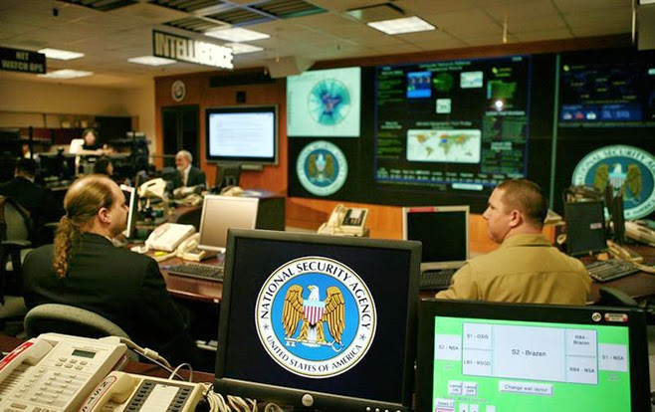
The government has a right to spy on its citizens in order to better protect its citizens.
This image is courtesy of healthinforwars.blogspot.com

Slide 2
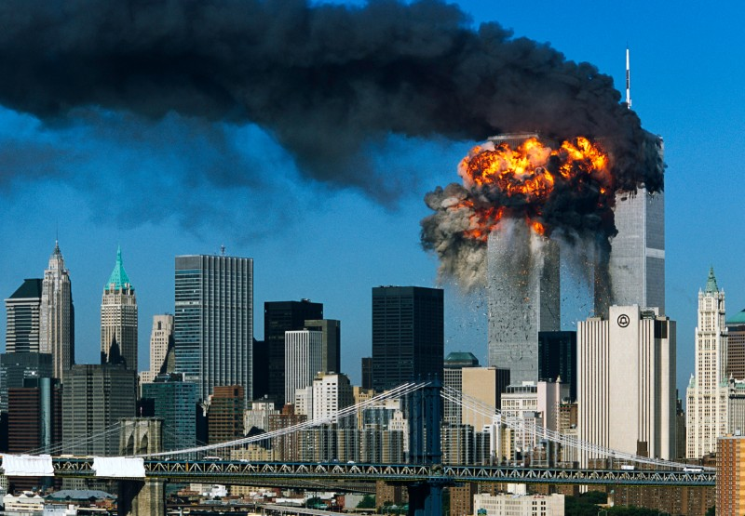
Following the terrorist attacks on September 11, 2001, the United States Congress passed the USA Patriot Act. One section of the act allows the government to “query telephone metadata.”
The purpose is to access electronic records of suspected terrorists. This image is courtesy of whowhatwhy.org.

Slide 3
This means that the National Security Agency was able to legally seize telephone and text records of virtually every citizen in the United States.
This image is courtesy of cbsnews.com.

Slide 4
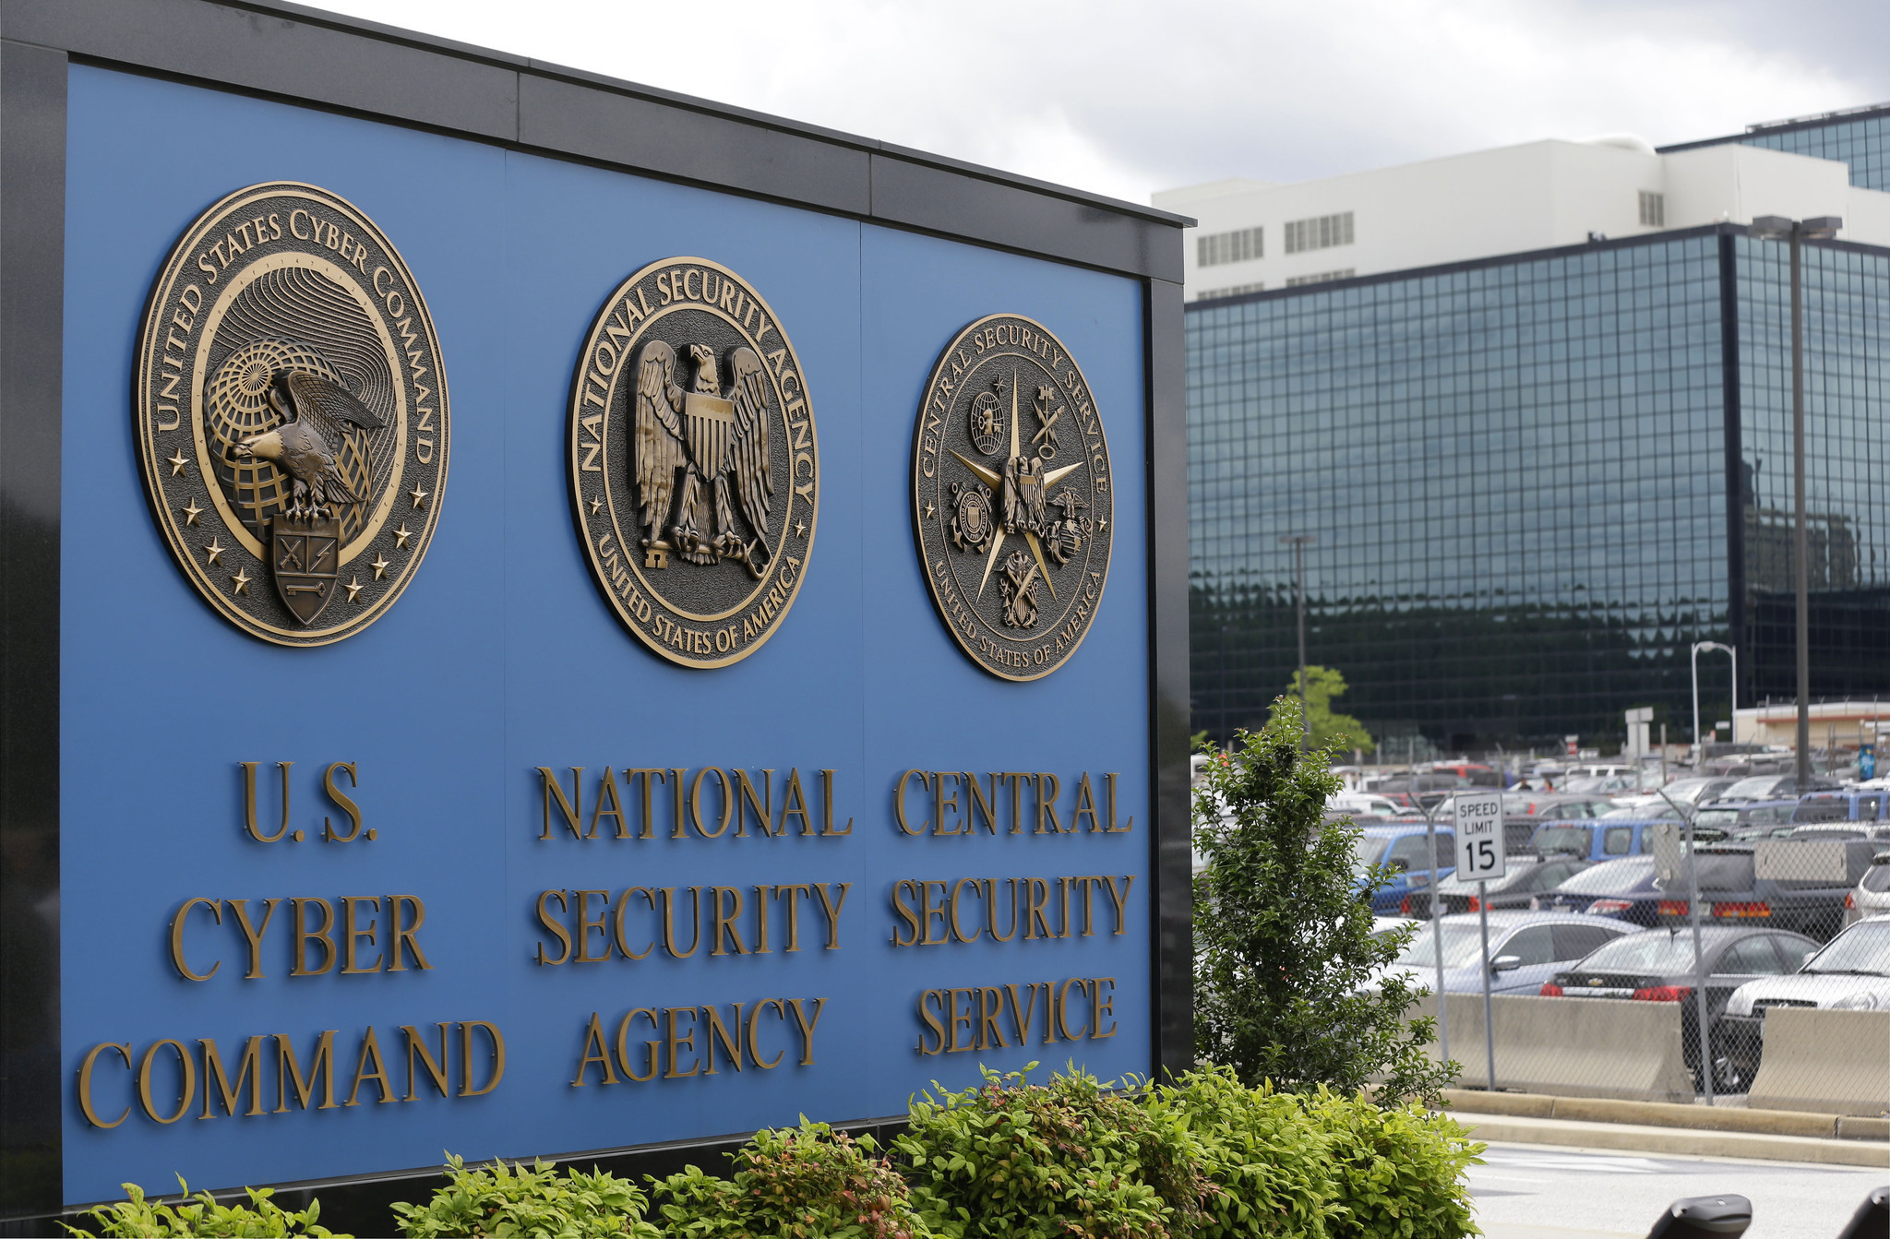
United States’ telecommunication companies (Verizon, AT&T, Sprint) were legally forced to turn over data on every United States citizen.
They did this under a program called PRISM. This image is courtesy of cbsnews.com.

Slide 5
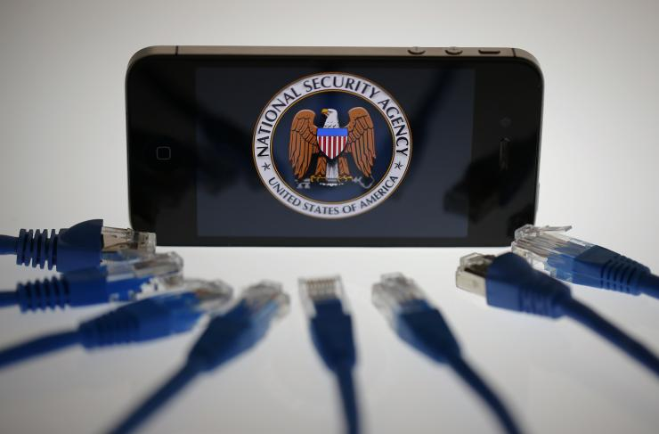
Surveillance programs have been used to legally search “nearly everything a user does on the Internet” through data that it intercepts around the world.
They did this under a program called XKeyscore. This image is courtesy of ibtimes.com.

Slide 6
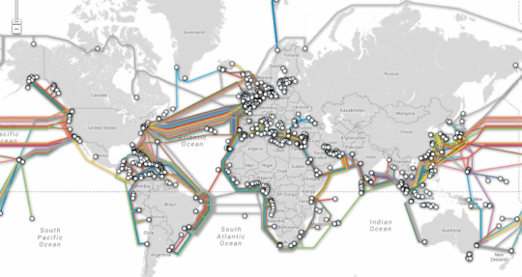
Undersea fiber optic cables are legally accessed by a British spy agency in a partnership with the United States’ National Security Agency.
The British spy agency is called Government Communications Headquarters (GCHQ). According to Edward Snowden, the GCHQ “vacuums up all data indiscriminately, regardless of who it belongs to or what the content of that data is.” This image is courtesy siliconangle.com.

Slide 7
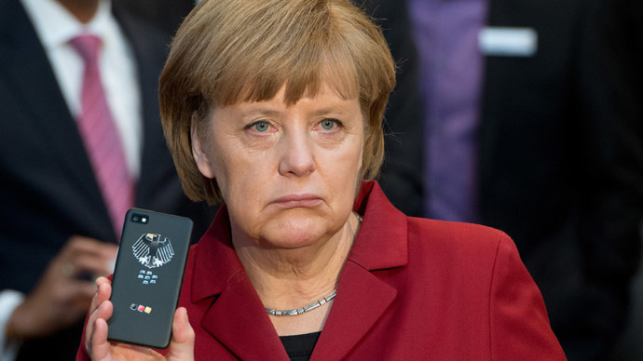
The electronic communications of at least 122 world leaders were intercepted by the United States, including the communications of some of our closest allies.
This is German Chancellor Angela Merkel after finding out the United States was monitoring her phone calls and texts. This image is courtesy rt.com.

Slide 8
The United States is intercepting millions of telephone communications in foreign countries.
The NSA is in the process of placing a large network of clandestine surveillance “sensors” in various locations around the world. This image is courtesy of theintercept.com.

Slide 9
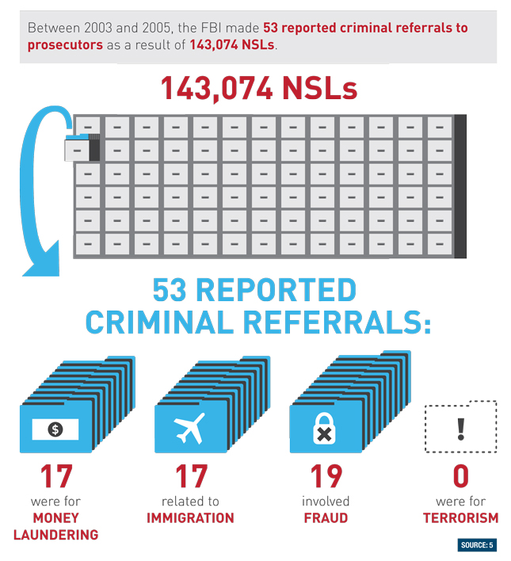
Another section of the Patriot Act established National Security Letters (NSL). The FBI can send a letter to a company to hand over email and financial records without a court order.
This image is courtesy of pantprogressive.tumblr.com.

Slide 10
A National Security Letter (NSL) could also include a “gag order,” meaning companies could not tell anyone, even the person whose records they disclosed, that they had received a letter.
This image is courtesy of wired.com.

Slide 11
The Patriot Act also allowed for a special court, called the FISA Court, to operate largely in secret.
FISA stands for The United States Foreign Intelligence Surveillance Court. This image is courtesy of breitbart.org.

Slide 12
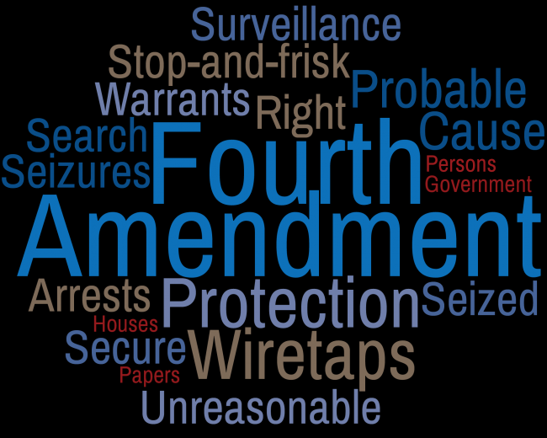
The FISA court ruled that mass data collection by the NSA did not violate the 4th Amendment (Search and Seizure Amendment) of the Constitution.
FISA stands for The United States Foreign Intelligence Surveillance Court. This image is courtesy of uscourts.com.

Slide 13
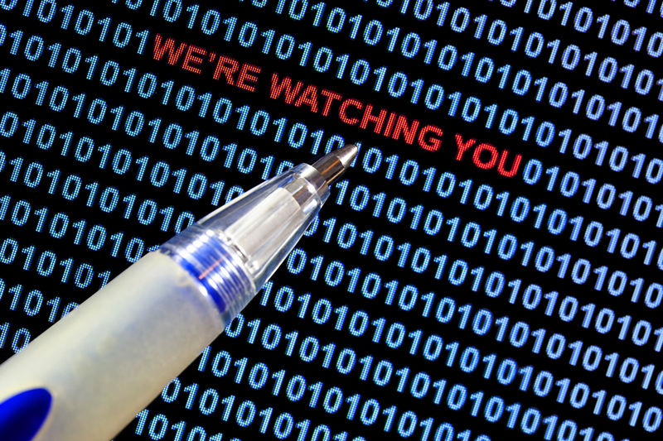
The FISA Court ruled that because customers gave telecommunications companies, personal information, the government was allowed to collect that information in secret.
This image is courtesy of dailykos.com.

Slide 14
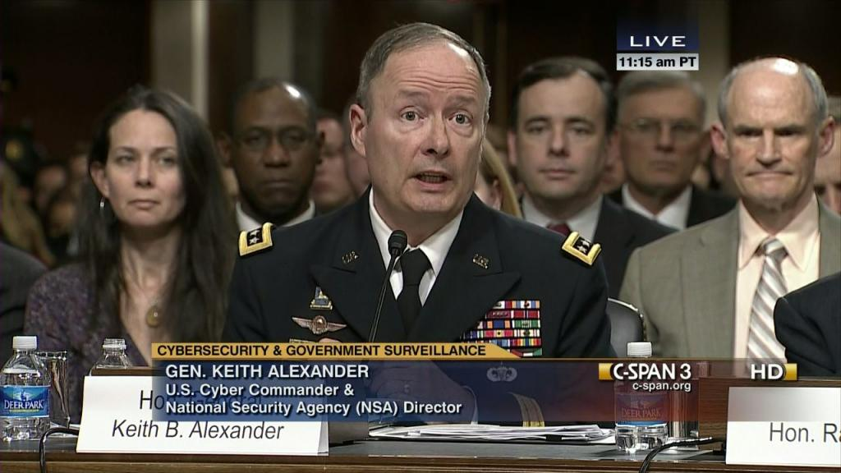
The government at first denied that it was collecting information on its citizens.
Government officials denied spying, under oath, before congressional committees in 2012 and 2013. This image is courtesy of c-span.org.

Slide 15
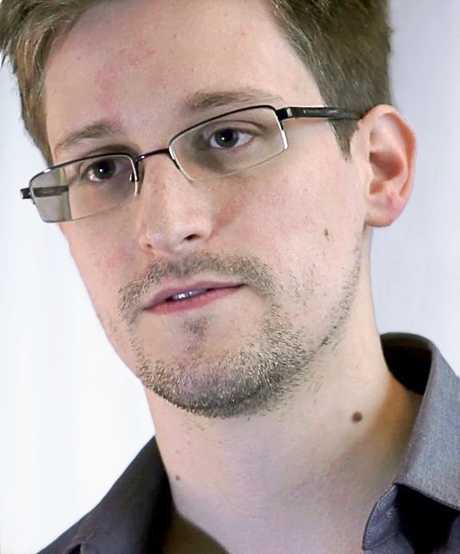
The extent of the government’s spying under the Patriot Act was revealed by a former NSA employee, Edward Snowden, who gave thousands of classified documents to journalists.
This image is courtesy of Wikimedia Commons.

Slide 16
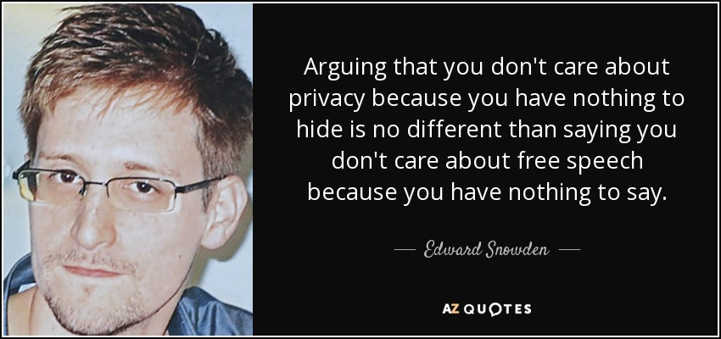
Edward Snowden is now in hiding for violating the Espionage Act, and for theft of government property.
This image is courtesy of azquotes.com.

Slide 17
The government has a right to spy on its citizens in order to better protect its citizens.
This image is courtesy of healthinforwars.blogspot.com

Slide 18
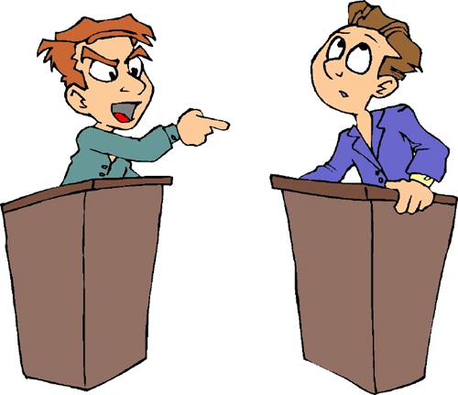
Good debaters use stories and anecdotes to support their argument.
These stories are in a lot of newspaper and magazine articles that you will read online. This image is courtesy of gova-lhs.wikispaces.com

Slide 19
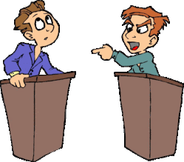
Additionally, you will use Facts not Bias to support your arguments.
This image is courtesy of gova-lhs.wikispaces.com

Slide 20
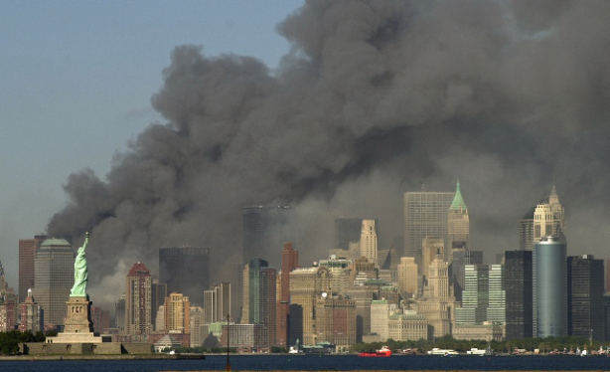
Bias: Americans have a good chance of being killed in a terrorist attack.
This image shows New York Harbor and the Statue of Liberty on September 11, 2001. This image is courtesy of truthernews.wordpress.com

Slide 21
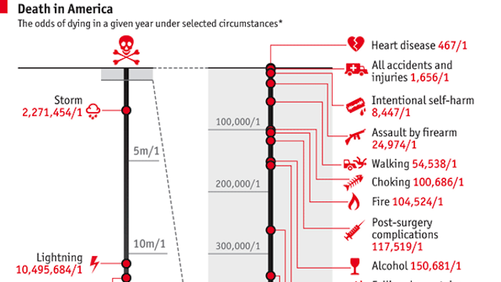
Fact: The odds of an American being killed in a terrorist attack is about 1 in 20 million. https://www.washingtonpost.com/news/wonk/wp/2013/09/11/nine-facts-about-terrorism-in-the-united-states-since-911/
Your odds of dying in a terrorist attack are much lower than dying from just about anything else, including being struck by lightning. This image is courtesy of washingtonpost.com

Slide 22
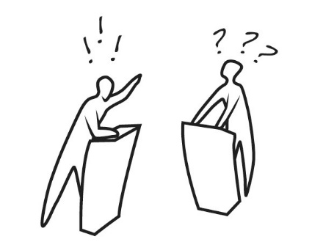
The debate will be during class on Monday, December 11th.
This image is courtesy of www.lastbastile.wordpress.com

Slide 23
Proper methods to make a statement during a debate.
When you want to take a position, say:
--- “It is my position that…”
--- “I am going to argue that…”
When you want to give reasons:
---“One reason that…”
---“ Another reason that…”
When you want to offer evidence:
--- “An example that shows this is…”
---“Specifically, a line/part that shows this is…”
--- “In particular, this part…”
When you want to be sure you are showing how the evidence proves your points:
--- “This shows that…”
--- “This means that…”

Slide 24
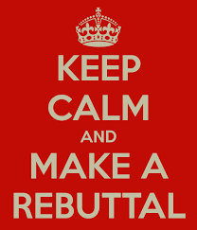
Both sides will make rebuttals to the one minute statements. The rebuttals will be for approximately 1 Minute.
During Rebuttal, a student should: A. Rebut a previous statement by an opponent OR
B. Ask a specific opponent a question about the opponent’s previous statement.
This image is courtesy of keepcalm0matic.co.uk.

Slide 25
Proper methods to make a rebuttal during a debate.
When you want to consider how to reject a counter argument or rebuttal:
--- “On the other hand.. yet, despite this…”
--- “Still there are those who would claim… yet, I disagree…”
--- “Others may feel… nevertheless, I contend that…”
When you want to rebut
--- “So your point is… but that overlooks…”
--- “So you are saying…however, that still does not explain…”
--- “So you are claiming… yet what about the fact that…”

Slide 26
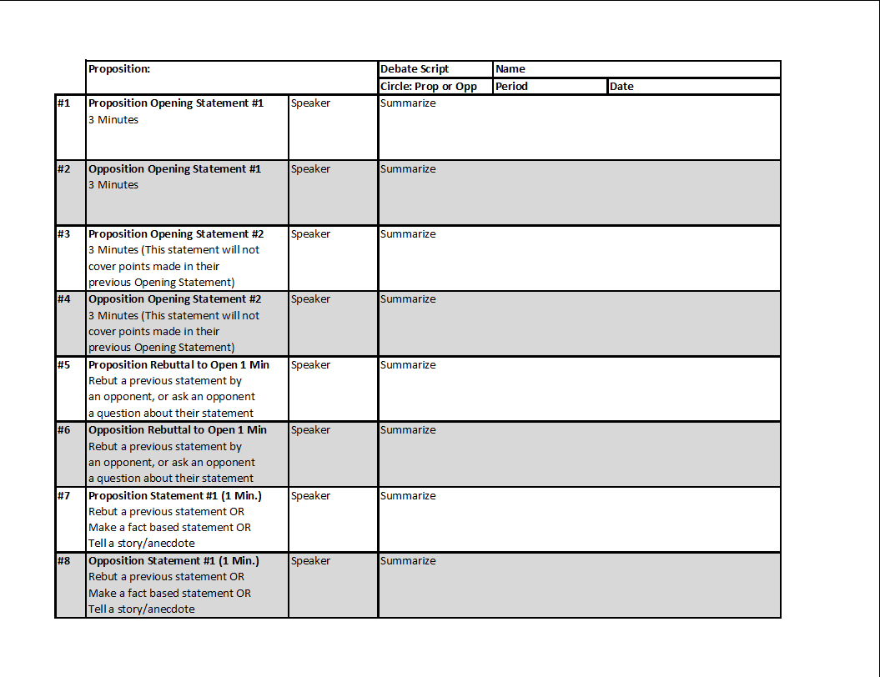
Use your Debate Scripts to understand exactly where we are in the debate, and what is being said in the debate.
The debate script shows step by step who is supposed to speak and when. First put your Name, Period, and Date on the script. This image was created by Mr. Robert Housch.

Slide 27
Write in the Proposition on your Debate Script: The government has a right to spy on its citizens in order to better protect its citizens.
Then circle if you are on the Proposition side, or on the Opposition side. This image was created by Mr. Robert Housch.

Slide 28
Possible Way for your group to divide up this topic:
A. Should the government be allowed to make “bulk data” collections of telephone, location, and internet data of its citizens?
B. Do Americans need to sacrifice civil liberties in order to be safe from terrorism?
C. Is the government, with its electronic surveillance of American citizens, able to adequately protect its citizens?
D. Should American citizens have 100% control over their personal information and who can have access to that information?
E. Do government surveillance programs change the way that American citizens use their e-mail accounts, search engines, social media sites, cell phones, text messages, and other ways that they use technology?
F. Should the United States government monitor e-mails, telephone calls, and location and internet data of all other citizens and leaders of the world, including those countries that are allies of the United States?
G. Is Edward Snowden a hero or a traitor?
H. How many Americans own/have home internet access, use electronic devices, and use social networking sites? How frequently?
I. Is mass electronic surveillance a waste of security resources? Is there too much data collected to provide useful information in the fight against terrorism?
J. How many terrorist attacks have we prevented, and/or how many terrorists have been caught, with the assistance of electronic surveillance? How many terror plots/attacks have been prevented without the use of electronic surveillance?
K. If you have nothing to hide, why should you be bothered by the government looking through your data? Shouldn’t guilty people be the only ones worried about mass surveillance? If you willingly give personal information to your phone company, or your bank, or your doctor, then does it really matter if the government also has access to that information?
L. With the government collecting our personal information, how safe do you feel that they can keep that information private from other countries that are hacking into computer systems, or from other individuals?

Slide 29
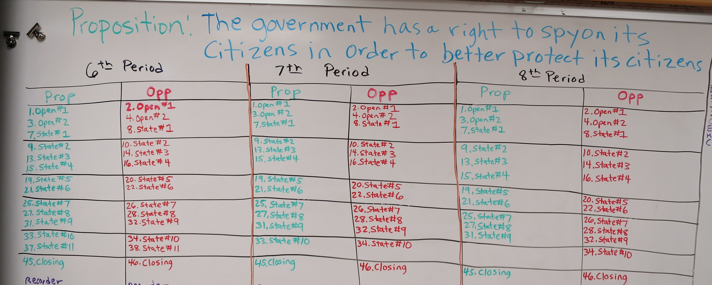
When you are instructed, we will divide our topics, Opening Statement, Closing Statement, etc….
Write a summary of your statements in the box which is labeled “summarize.” The teacher will write beside the numbers the name of the person doing the statement, and the letter of the topic they are doing. This image was created by Mr. Robert Housch.

Slide 30
While someone is speaking, write on your debate script in the box labeled “Speaker” who is speaking, and in the box labeled “Summarize” a brief description of what they said.
When someone is speaking, you should be constantly writing on the script. This image was created by Mr. Robert Housch.

Slide 31
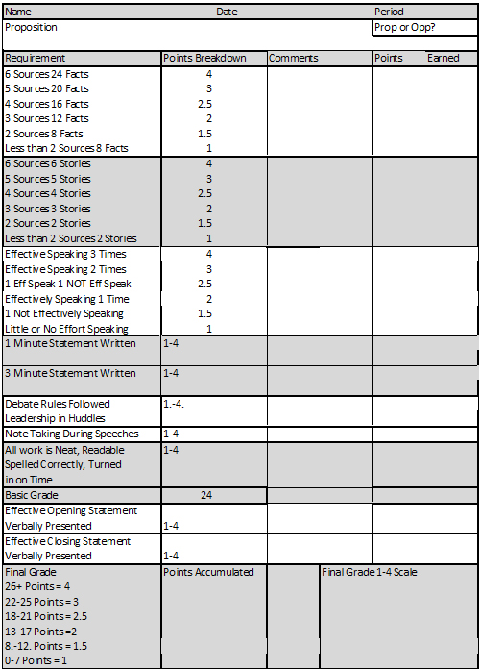
Your final grade for the debate will be placed on the Debate Rubric.
One may earn extra points by either giving the opening argument or the closing argument to their side of the debate. This image was created by Robert Housch.

Slide 32
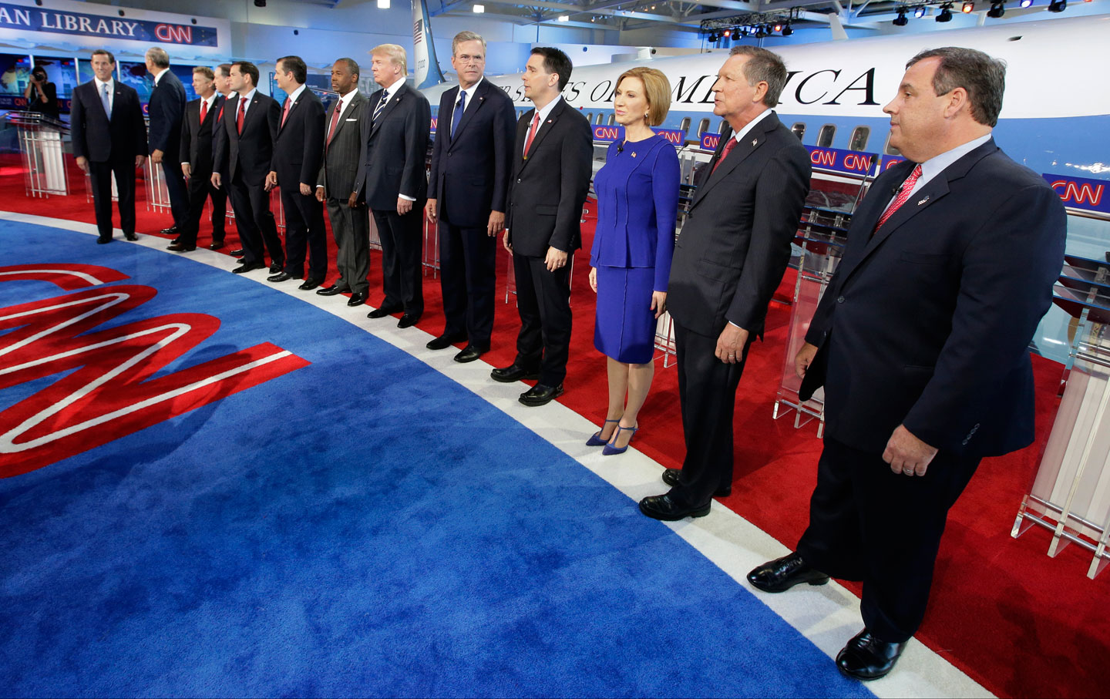
You are now going to research in preparation for the debate.
You will use your debate script and the debate script power point/PDF. This image is courtesy of thenation.com

Slide 33
During your research, don’t automatically raise your hand to ask Mr. Housch a question about what something means.
You have a powerful tool at your disposal called the internet. Look up words on websites such as dictionary.com or wikipedia.com. This image is courtesy of photomatt7.wordpress.com

Slide 34
Possible Way for your group to divide up this topic:
A. Should the government be allowed to make “bulk data” collections of telephone, location, and internet data of its citizens?
B. Do Americans need to sacrifice civil liberties in order to be safe from terrorism?
C. Is the government, with its electronic surveillance of American citizens, able to adequately protect its citizens?
D. Should American citizens have 100% control over their personal information and who can have access to that information?
E. Do government surveillance programs change the way that American citizens use their e-mail accounts, search engines, social media sites, cell phones, text messages, and other ways that they use technology?
F. Should the United States government monitor e-mails, telephone calls, and location and internet data of all other citizens and leaders of the world, including those countries that are allies of the United States?
G. Is Edward Snowden a hero or a traitor?
H. How many Americans own/have home internet access, use electronic devices, and use social networking sites? How frequently?
I. Is mass electronic surveillance a waste of security resources? Is there too much data collected to provide useful information in the fight against terrorism?
J. How many terrorist attacks have we prevented, and/or how many terrorists have been caught, with the assistance of electronic surveillance? How many terror plots/attacks have been prevented without the use of electronic surveillance?
K. If you have nothing to hide, why should you be bothered by the government looking through your data? Shouldn’t guilty people be the only ones worried about mass surveillance? If you willingly give personal information to your phone company, or your bank, or your doctor, then does it really matter if the government also has access to that information?
L. With the government collecting our personal information, how safe do you feel that they can keep that information private from other countries that are hacking into computer systems, or from other individuals?

Slide 35
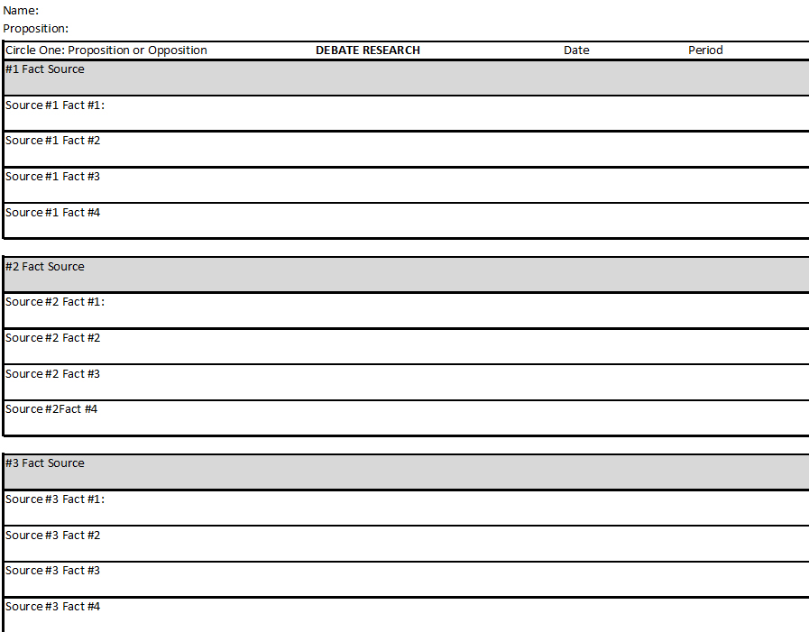
Fill out the Debate Template as you do your research.
First fill in your name, and the Proposition: “The government has a right to spy on its citizens in order to better protect its citizens.” This image is courtesy of Mr. Robert Housch.

Slide 36
We are working on “Facts” for 10-12 minutes. These are any facts whether they agree with your position or not. (You need to understand both sides). You will see a line with a “Fact Source.” Below that are as many as four facts that you acquired from that source.
6 Sources and 24 Facts is a “4.” 5 Sources and 20 Facts is a “3.” 4 Sources and 16 Facts is a “2.5.” 3 Sources and 12 Facts is a “2.” 2 Sources and 8 Facts is a “1.5” Below 2 Sources and 8 Facts is a “1.” This image is courtesy of Mr. Robert Housch.

Slide 37
Miscellaneous Research Sites for Facts on Privacy vs. Security (Neutral)
https://www.techdirt.com/articles/20140401/17575126774/member-intelligence-review-group-tells-nsa-you-guys-have-done-amazing-work-protecting-america-should-never-ever-be-trusted.shtml
https://www.pewresearch.org/politics/2021/09/02/two-decades-later-the-enduring-legacy-of-9-11/
http://www.npr.org/2013/11/22/246774367/debate-does-spying-keep-us-safe
Note: You will have to use your headphones to listen to the debate, or a PDF transcript of the debate is located on mrhousch.com/Debates/Privacy vs. Security. The PDF transcript is titled: “Spy on Me, I’d Rather Be Safe.”
http://debatewise.org/debates/3040-privacy-vs-security/
https://www.brookings.edu/articles/avoiding-a-showdown-over-eu-privacy-laws/
https://en.wikipedia.org/wiki/Global_surveillance
https://en.wikipedia.org/wiki/Terrorist_Surveillance_Program#:~:text=The%20Terrorist%20Surveillance%20Program%20was,the%20September%2011%2C%202001%20attacks.

Slide 38
Miscellaneous Research Sites for Facts on Privacy vs. Security (Neutral)
https://www.propublica.org/article/nsa-data-collection-faq
https://en.wikipedia.org/wiki/PRISM
https://www.pewresearch.org/short-reads/2018/06/04/how-americans-have-viewed-government-surveillance-and-privacy-since-snowden-leaks/
https://www.eff.org/nsa-spying/how-it-works
https://techcrunch.com/2019/04/30/nsa-surveillance-spike/

Slide 39
Miscellaneous Research Sites for Facts on Privacy vs. Security (Neutral)
https://www.theperspective.com/debates/national-security-outweigh-right-privacy/
https://www.bloomberg.com/quicktake/privacy-vs-security
https://www.govtech.com/policy/privacy-vs-security-experts-debate-merits-of-each-in-tech-rich-world.html
https://techcrunch.com/2018/05/06/personal-privacy-vs-public-security-fight/

Slide 40
Nsa.gov Research Site for Facts on Privacy vs. Security (Proposition)
https://nsa.gov1.info/surveillance/ How your data becomes our data
https://www.dailydot.com/news/house-fisa-email-surveillance-extension/
https://nsa.gov1.info/data/index.html If you have nothing to hide, you have nothing to fear
https://nsa.gov1.info/index.html Domestic Surveillance Directorate
https://nsa.gov1.info/partners/index.html Partners
https://nsa.gov1.info/utah-data-center/index.html Utah Data Center Background
https://nsa.gov1.info/jobs/index.html Want to work for the NSA?
https://nsa.gov1.info/about/index.html We work for the good of the nation

Slide 41
Cia.gov Research Site for Facts on Privacy vs. Security (Proposition)
https://www.cia.gov/about/
https://www.cia.gov/careers
https://www.cia.gov/legacy/
https://www.cia.gov/careers/student-programs/
https://www.cia.gov/legacy/cia-history/
https://www.cia.gov/about/mission-vision/

Slide 42
Miscellaneous Research Sites for Facts on Privacy vs. Security (Prop)
http://www.heritage.org/defense/report/section-215-the-patriot-act-and-metadata-collection-responsible-options-the-way
https://www.nsa.gov/Culture/Civil-Liberties-and-Privacy/
http://www.darkreading.com/endpoint/privacy/nsas-big-surprise-govt-agency-is-actually-doing-its-job/d/d-id/1141660

Slide 43
Miscellaneous Research Sites for Facts on Privacy vs. Security (Opp)
https://www.lawfareblog.com/topic/surveillance
https://www.aclu.org/fact-sheet/documents-confirm-how-nsas-surveillance-procedures-threaten-americans-privacy
https://www.eff.org/nsa-spying/faq
https://iapp.org/news/a/the-snowden-disclosures-10-years-on/
https://www.eff.org/nsa-spying/how-it-works
https://www.usatoday.com/story/news/politics/2013/06/16/snowden-whistleblower-nsa-officials-roundtable/2428809/
https://en.wikipedia.org/wiki/Nothing_to_hide_argument
https://www.eff.org/deeplinks/2013/11/busting-eight-common-excuses-nsa-surveillance
https://www.aclu.org/news/national-security/you-may-have-nothing-hide-you-still-have-something-fear

Slide 44
Miscellaneous Research Sites for Facts on Privacy vs. Security (Opp)
https://www.wired.com/2013/06/why-i-have-nothing-to-hide-is-the-wrong-way-to-think-about-surveillance/
https://www.wired.com/2013/09/lavabit-appeal/
http://www.cnn.com/2015/02/04/politics/deena-zaru-internet-privacy-security-al-franken/
https://www.theverge.com/2017/1/22/14350496/secure-email-service-lavabit-relaunches
https://debatewise.org/3040-privacy-vs-security/
https://www.forbes.com/sites/kevinanderton/2017/02/16/privacy-versus-security-how-americans-view-the-issue-of-encryption-infographic/#4e2ce16a25aa
http://www.pewinternet.org/2017/01/26/americans-and-cybersecurity/
https://euideas.eui.eu/2020/10/23/security-vs-liberty-the-terms-of-a-flawed-but-persistent-discourse/

Slide 45
Jack Teixeira Air Force Airman accused of leaking documents. (Opp)
https://en.wikipedia.org/wiki/Jack_Teixeira
https://apnews.com/article/leaked-documents-air-national-guardsman-jack-teixeira-d7c8dbaeb3b7a5ae69faeab04ede2ab0 Wanted to kill a “ton” of people.
https://www.npr.org/2023/04/27/1170844422/jack-teixeira-classified-documents-detention-hearing Had “lots” of weapons.
https://www.usatoday.com/story/news/politics/2023/04/28/jack-teixeira-security-clearance/11751171002/ How did he get a top secret security clearance?

Slide 46
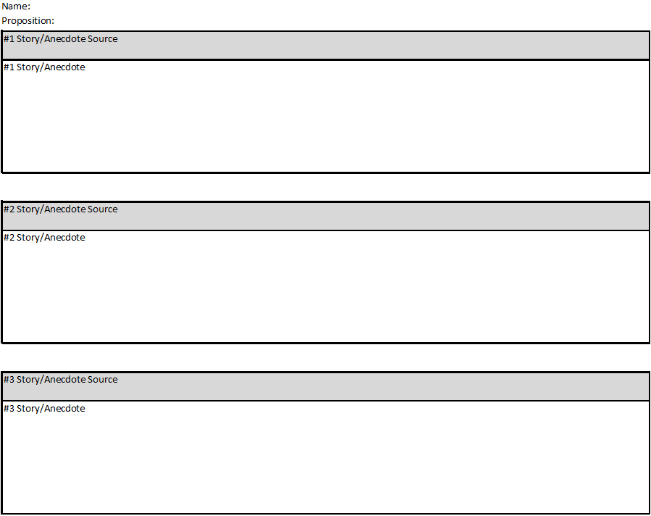
We are working on “Stories” for 10-12 minutes. Concentrate on stories for your side first, then look at stories from the other side. (You need to understand both sides). You will see a line with a “Story/Anecdote Source.” Below that write one story from that source.
6 Sources and 6 Stories is a “4.” 5 Sources and 5 Stories is a “3.” 4 Sources and 4 Stories is a “2.5.” 3 Sources and 3 Stories is a “2.” 2 Sources and 2 Stories is a “1.5” Below 2 Sources and 2 Stories is a “1.” This image is courtesy of Mr. Robert Housch.

Slide 47
Stories (Neutral)
While the previously mentioned research sites for “Facts” contain stories about Privacy vs. Security, one of the best way to obtain these stories is to go to:
google.com and/or
Youtube.com
and type in words such as “government spying stories” in the search area.
This will allow you to see results such as:
http://projects.propublica.org/graphics/nsa-54-cases
https://www.youtube.com/watch?v=V9_PjdU3Mpo Safe and Sorry– Terrorism & Mass
Surveillance

Slide 48
Stories (Proposition)
While the previously mentioned research sites for “Facts” contain stories about Privacy vs. Security, one of the best ways to obtain these stories is to go to
google.com and/or
youtube.com
And type in words such as “government monitoring and protecting us” or “terrorist attacks” in the search area. This will allow you to see results such as:
https://en.wikipedia.org/wiki/1993_World_Trade_Center_bombing
https://en.wikipedia.org/wiki/September_11_attacks
https://en.wikipedia.org/wiki/2001_anthrax_attacks
https://en.wikipedia.org/wiki/Beltway_sniper_attacks
https://en.wikipedia.org/wiki/2009_Fort_Hood_shooting
https://en.wikipedia.org/wiki/Boston_Marathon_bombing
https://en.wikipedia.org/wiki/2015_Chattanooga_shootings
https://en.wikipedia.org/wiki/2015_San_Bernardino_attack
https://www.youtube.com/watch?v=_3colChnneA Steps to Prevent Terrorist Attacks
https://www.youtube.com/watch?v=mXDuuIvb1KU 10 Failed Terrorist Attacks

Slide 49
Stories (Opposition)
While the previously mentioned research sites for “Facts” contain stories about Privacy vs. Security, one of the best ways to obtain these stories is to go to
google.com and/or
youtube.com
and type in words such as “government spying stories” in the search area.
This will allow you to see results such as:
http://www.washingtontimes.com/news/2015/may/21/fbi-admits-patriot-act-snooping-powers-didnt-crack/?page=all
http://thedailybanter.com/2013/08/another-wild-story-about-government-spying-circulates-the-internet-only-to-be-debunked-later/
https://en.wikipedia.org/wiki/Edward_Snowden
https://en.wikipedia.org/wiki/PRISM_%28surveillance_program%29
https://theintercept.com/2015/12/17/a-secret-catalogue-of-government-gear-for-spying-on-your-cellphone/
https://www.newyorker.com/magazine/2022/04/25/how-democracies-spy-on-their-citizens

Slide 50
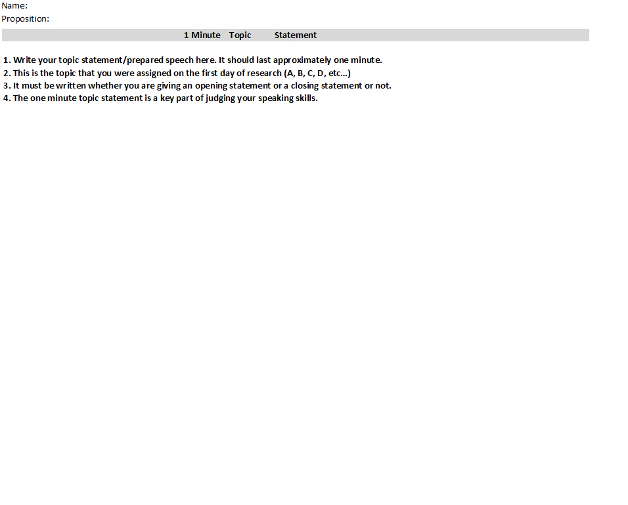
We are working on your one minute speech for 10-12 minutes. This speech should concentrate on the Letter/Subject that you chose for the debate.
Those giving an opening or closing statement can choose whatever subject/letter that they would like for their one minute topic. Everyone will be speaking during the debate. Most will be giving this approximately one minute statement. This image is courtesy of Mr. Robert Housch.

Slide 51
Proper methods to make a statement during a debate.
When you want to take a position, say:
--- “It is my position that…”
--- “I am going to argue that…”
When you want to give reasons:
---“One reason that…”
---“ Another reason that…”
When you want to offer evidence:
--- “An example that shows this is…”
---“Specifically, a line/part that shows this is…”
--- “In particular, this part…”
When you want to be sure you are showing how the evidence proves your points:
--- “This shows that…”
--- “This means that…”

Slide 52
Your one minute statement should be based on whatever subject you chose from this list:
A. Should the government be allowed to make “bulk data” collections of telephone, location, and internet data of its citizens?
B. Do Americans need to sacrifice civil liberties in order to be safe from terrorism?
C. Is the government, with its electronic surveillance of American citizens, able to adequately protect its citizens?
D. Should American citizens have 100% control over their personal information and who can have access to that information?
E. Do government surveillance programs change the way that American citizens use their e-mail accounts, search engines, social media sites, cell phones, text messages, and other ways that they use technology?
F. Should the United States government monitor e-mails, telephone calls, and location and internet data of all other citizens and leaders of the world, including those countries that are allies of the United States?
G. Is Edward Snowden a hero or a traitor?
H. How many Americans own/have home internet access, use electronic devices, and use social networking sites? How frequently?
I. Is mass electronic surveillance a waste of security resources? Is there too much data collected to provide useful information in the fight against terrorism?
J. How many terrorist attacks have we prevented, and/or how many terrorists have been caught, with the assistance of electronic surveillance? How many terror plots/attacks have been prevented without the use of electronic surveillance?
K. If you have nothing to hide, why should you be bothered by the government looking through your data? Shouldn’t guilty people be the only ones worried about mass surveillance? If you willingly give personal information to your phone company, or your bank, or your doctor, then does it really matter if the government also has access to that information?
L. With the government collecting our personal information, how safe do you feel that they can keep that information private from other countries, that are hacking into computer systems, or from other individuals?

Slide 53
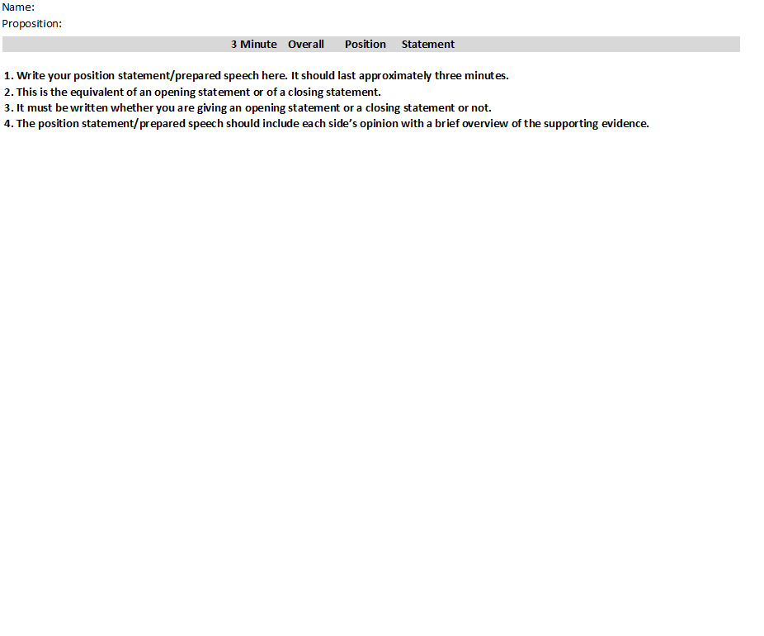
We are working on your three minute speech for 10-12 minutes. This speech can be a combination of any Letter/Subject that was shown as a topic for the debate.
This is the equivalent of an opening or closing statement. You must write this statement whether or not you are giving an opening statement or a closing statement during the debate. This image is courtesy of Mr. Robert Housch.

Slide 54
Proper methods to make a statement during a debate.
When you want to take a position, say:
--- “It is my position that…”
--- “I am going to argue that…”
When you want to give reasons:
---“One reason that…”
---“ Another reason that…”
When you want to offer evidence:
--- “An example that shows this is…”
---“Specifically, a line/part that shows this is…”
--- “In particular, this part…”
When you want to be sure you are showing how the evidence proves your points:
--- “This shows that…”
--- “This means that…”

Slide 55
Your three minute statement may be based on a combination of any items from this list:
A. Should the government be allowed to make “bulk data” collections of telephone, location, and internet data of its citizens?
B. Do Americans need to sacrifice civil liberties in order to be safe from terrorism?
C. Is the government, with its electronic surveillance of American citizens, able to adequately protect its citizens?
D. Should American citizens have 100% control over their personal information and who can have access to that information?
E. Do government surveillance programs change the way that American citizens use their e-mail accounts, search engines, social media sites, cell phones, text messages, and other ways that they use technology?
F. Should the United States government monitor e-mails, telephone calls, and location and internet data of all other citizens and leaders of the world, including those countries that are allies of the United States?
G. Is Edward Snowden a hero or a traitor?
H. How many Americans own/have home internet access, use electronic devices, and use social networking sites? How frequently?
I. Is mass electronic surveillance a waste of security resources? Is there too much data collected to provide useful information in the fight against terrorism?
J. How many terrorist attacks have we prevented, and/or how many terrorists have been caught, with the assistance of electronic surveillance? How many terror plots/attacks have been prevented without the use of electronic surveillance?
K. If you have nothing to hide, why should you be bothered by the government looking through your data? Shouldn’t guilty people be the only ones worried about mass surveillance? If you willingly give personal information to your phone company, or your bank, or your doctor, then does it really matter if the government also has access to that information?
L. With the government collecting our personal information, how safe do you feel that they can keep that information private from other countries, that are hacking into computer systems, or from other individuals?

Slide 56
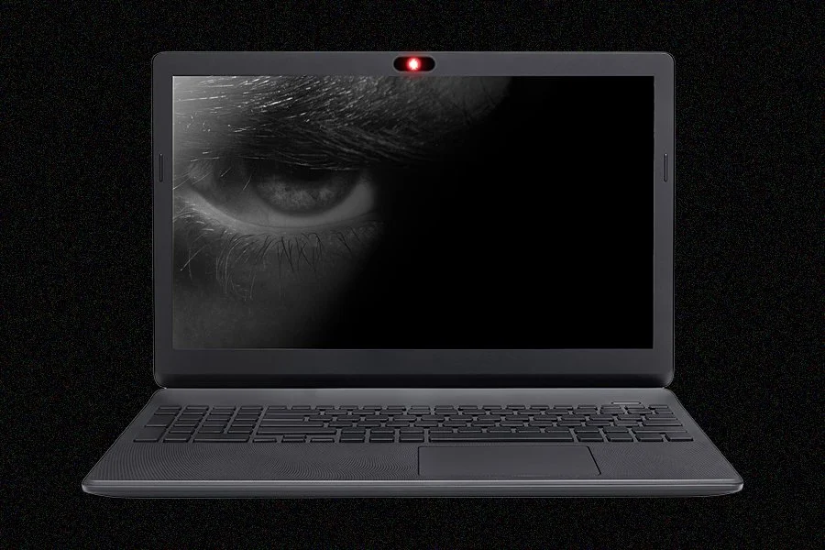
Take a picture of your work so that you can save it electronically.
Also, the government will also have a record of exactly what you are writing about it. This image is courtesy of brightsidelearning.com.

Slide 57
The debate will be during class on Monday, December 11th.
This image is courtesy of www.lastbastile.wordpress.com

