Slide 1
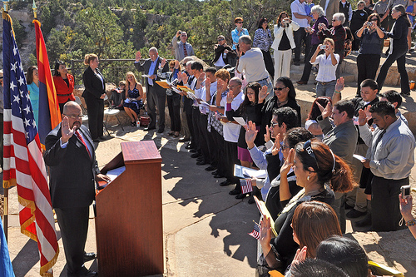
More immigrants should be allowed in the United States.
This image is courtesy of usimmigrationjourney.com

Slide 2
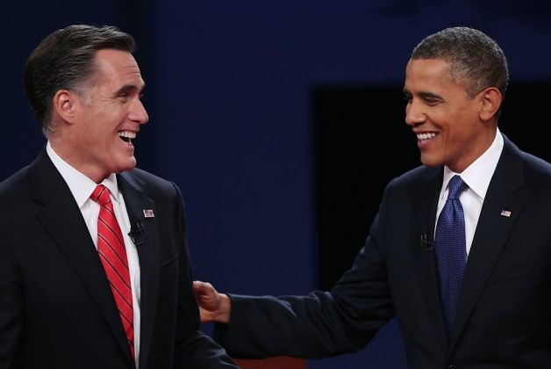
Debate Rules:
Be Polite and Courteous
This image shows Republican candidate Mitt Romney and Democrat President Barack Obama during their 2012 debate.
This image is courtesy of www.sfgate.com

Slide 3
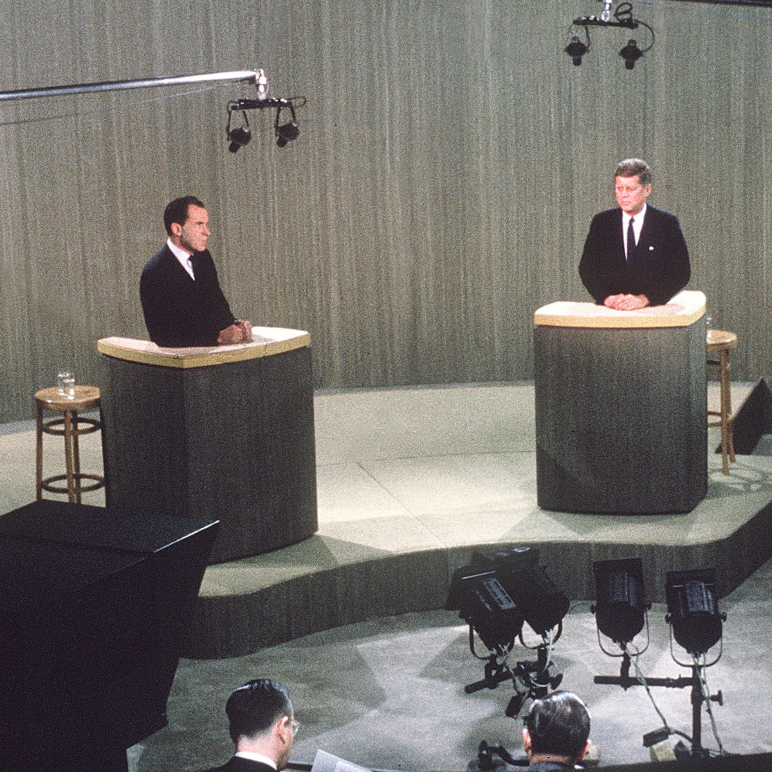
Debate Rules:
Listen Carefully to Both Sides
This image shows Republican Vice-President Richard M. Nixon and Democrat Senator John F. Kennedy during a 1960 debate. This image is courtesy of history.com.

Slide 4
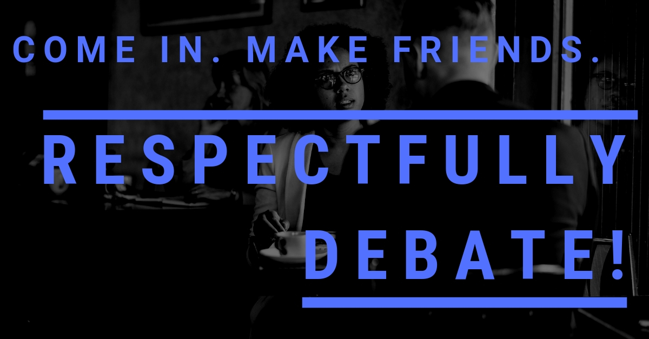
Debate Rules:
Be Respectful and Supportive of your fellow students
This image is courtesy of respectfullydebate.com.

Slide 5
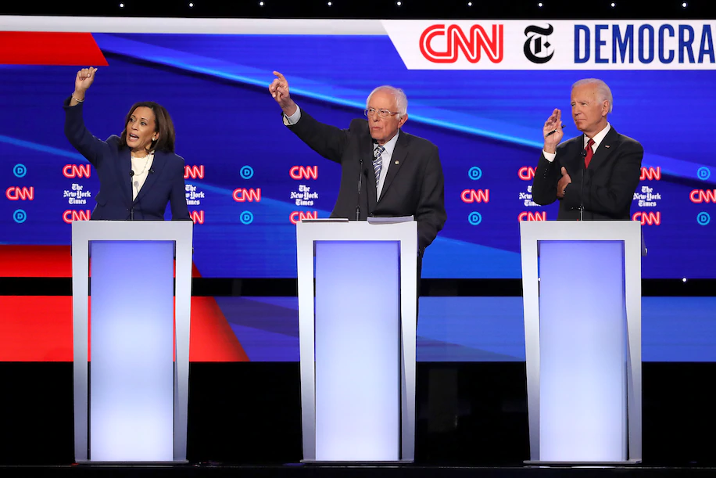
Debate Rules:
Avoid interrupting and making inappropriate noises during the debate.
This image shows Democrats Kamala Harris, Bernie Sanders, and Joe Biden during an October, 2019 debate. This image is courtesy of washingtonpost.com.

Slide 6
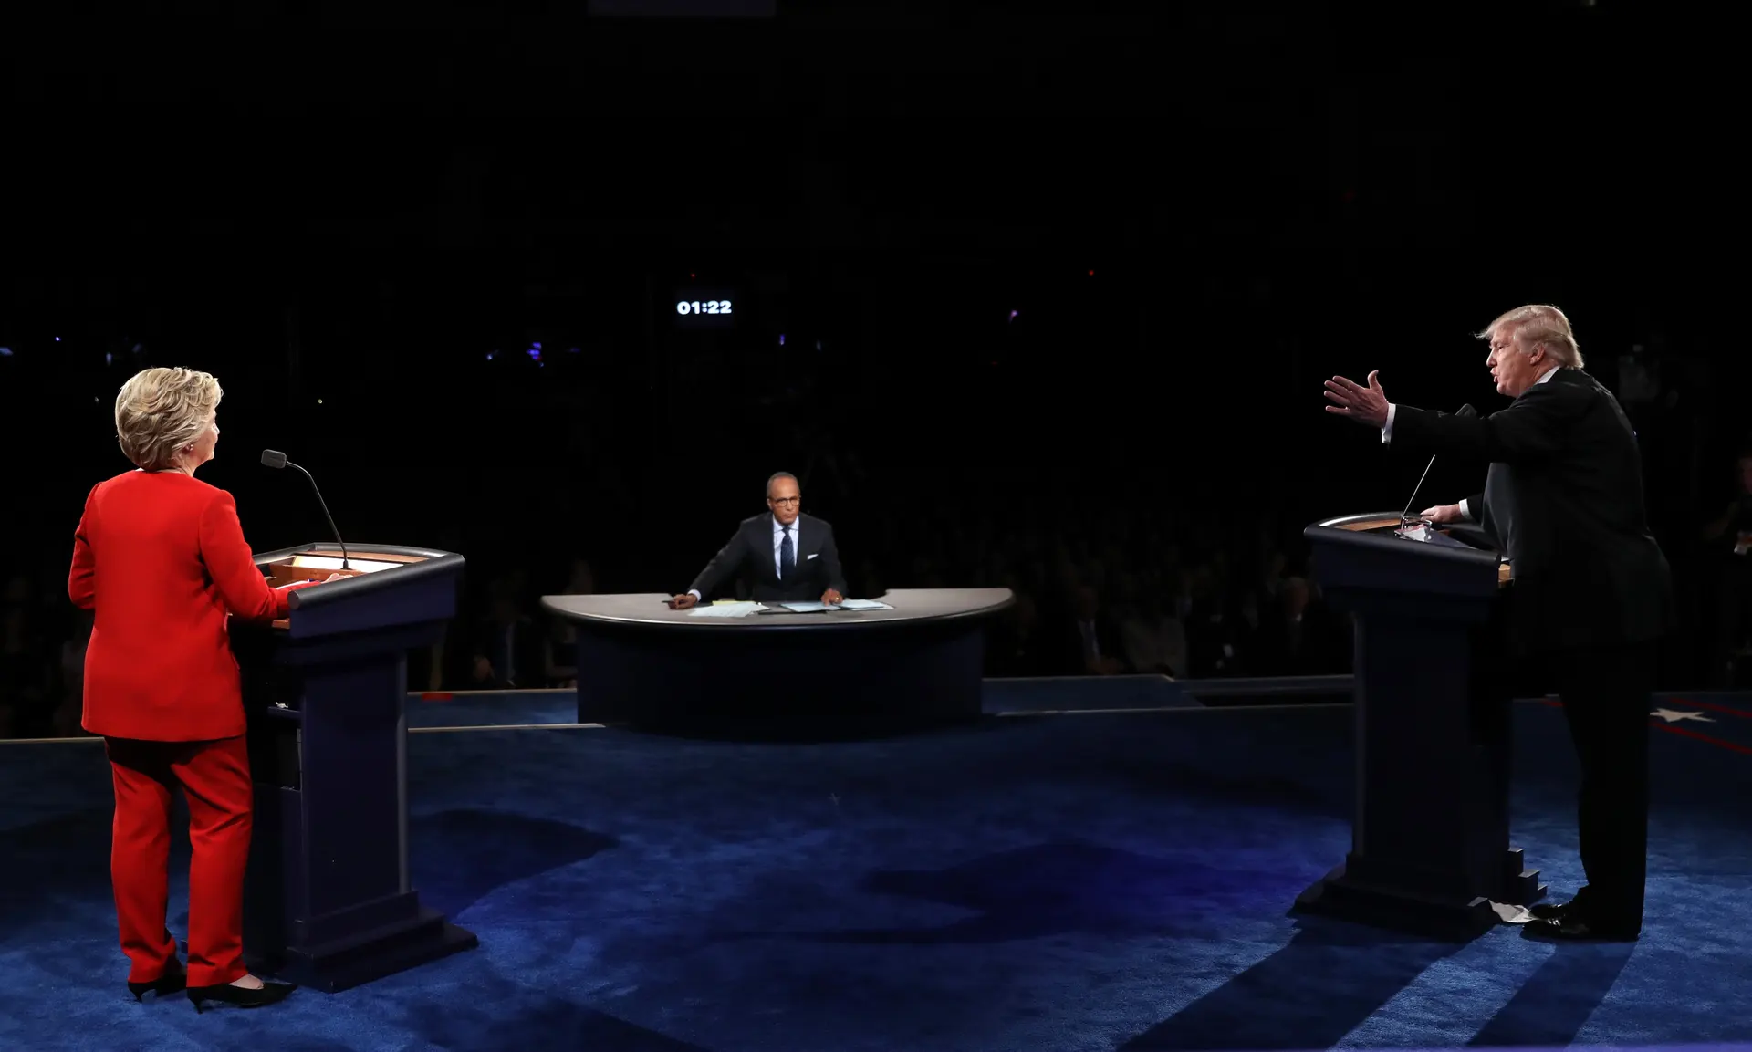
Debate Rules:
Speak only when recognized by the moderator
This image shows Democrat Hillary Clinton, moderator Lester Holt, and Republican Donald Trump during a 2016 Presidential debate.

Slide 7
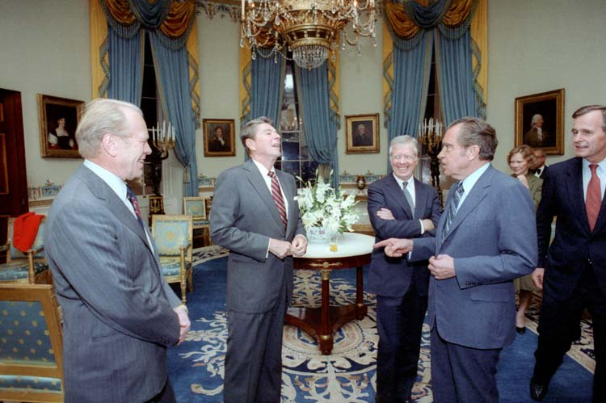
Debate Rules:
When you are in your huddles, allow others to express their opinions
This image shows presidents Ford, Reagan, Carter, Nixon, and then Vice-President George H.W. Bush in the White House Blue Room in 1981. This image is courtesy of whowhatwhy.com.

Slide 8
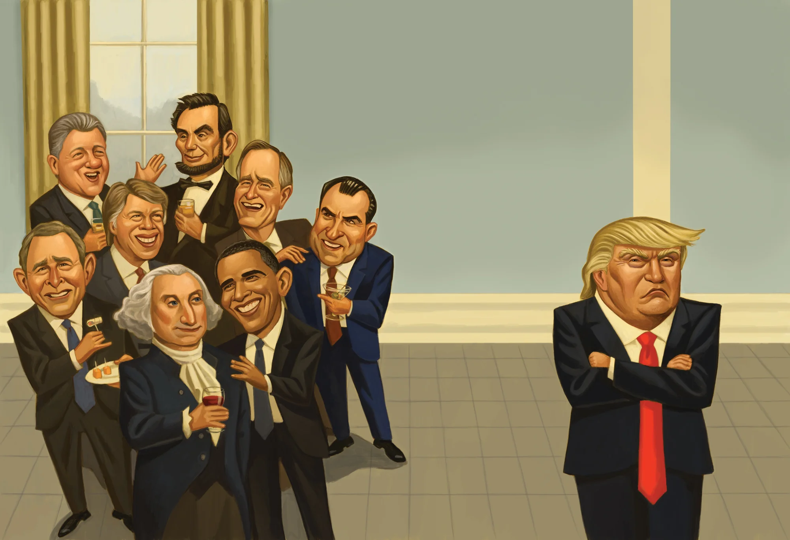
Debate Rules:
In the huddles, do not try to talk all the time without giving someone else their turn.
This image is courtesy of vanityfair.com.

Slide 9
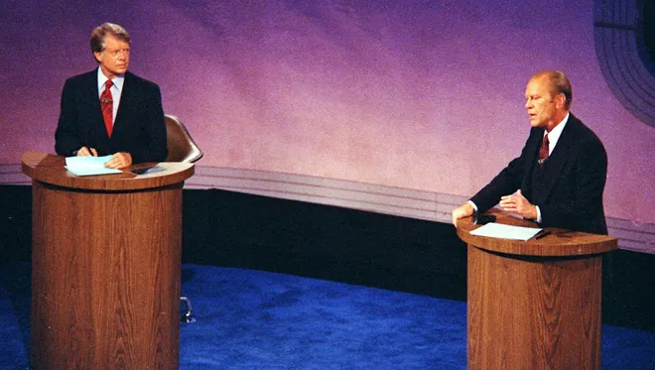
Debate Rules:
Use grammatically correct language (don’t sound like you're uneducated)
This image shows Democrat Governor Jimmy Carter and Republican President Gerald Ford during a Presidential debate in 1976. This image is courtesy of usatoday.com.

Slide 10
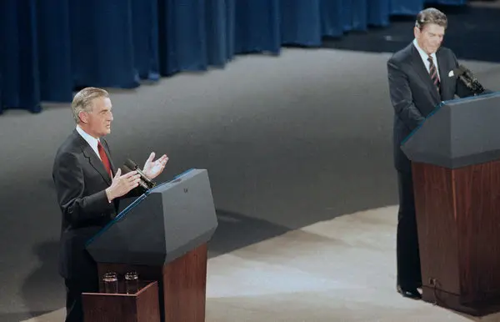
Debate Rules:
Speak clearly, slowly, and loud enough to be heard by the audience
This image shows Democrat Senator Walter Mondale and Republican President Ronald Reagan during a debate in 1984. This image is courtesy of nytimes.com.

Slide 11
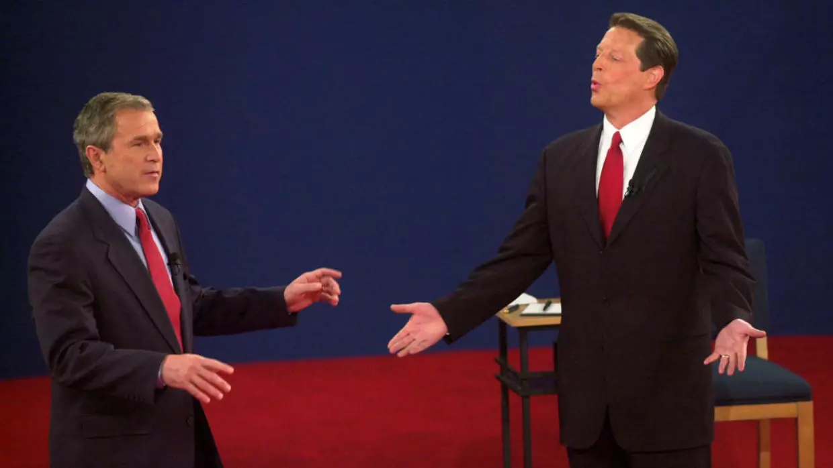
Debate Rules:
Speak with passion and excitement
This image shows Republican Governor George W. Bush and Democrat Vice President Al Gore during a Presidential Debate in 2000.

Slide 12
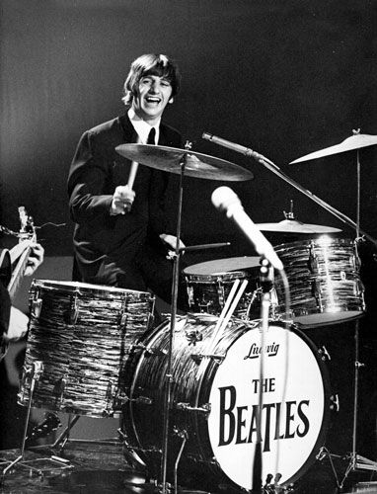
As someone moves to the podium to speak, everyone will give them a drum roll on your desks.
This photograph shows Beatles’ drummer Ringo Starr during the band’s performance on the Ed Sullivan Show on February 9, 1964. This image is courtesy of pinterest.com

Slide 13
Be prepared to come up when it is your turn. Don’t fumble around looking for your notes, etc…
It takes away from your amount of time, and it also takes away from the impact that your statement/rebuttal is supposed to make. This image is courtesy of pinterest.com

Slide 14
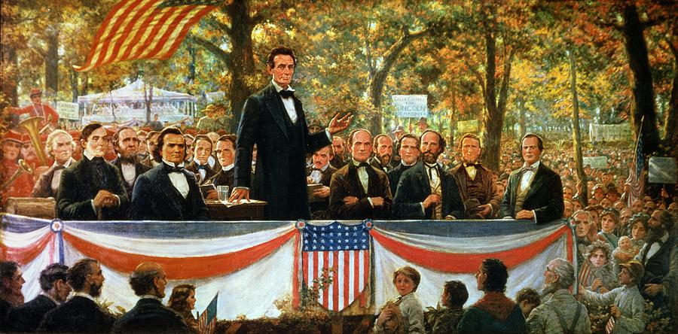
When you are speaking, have your head up and look at your audience, don’t only have your head down reading your notes.
Try to say what you want to say as much in your own words as possible. This image shows a scene from the fourth Lincoln-Douglas Debate in Charleston, Illinois, on September 18, 1858. Abraham Lincoln is speaking. Senator Stephen A. Douglas is seated to the left of Lincoln. This image was created by Robert Marshall Root (1863-1937). This image is courtesy of art-now-and-then.blogspot.com.

Slide 15
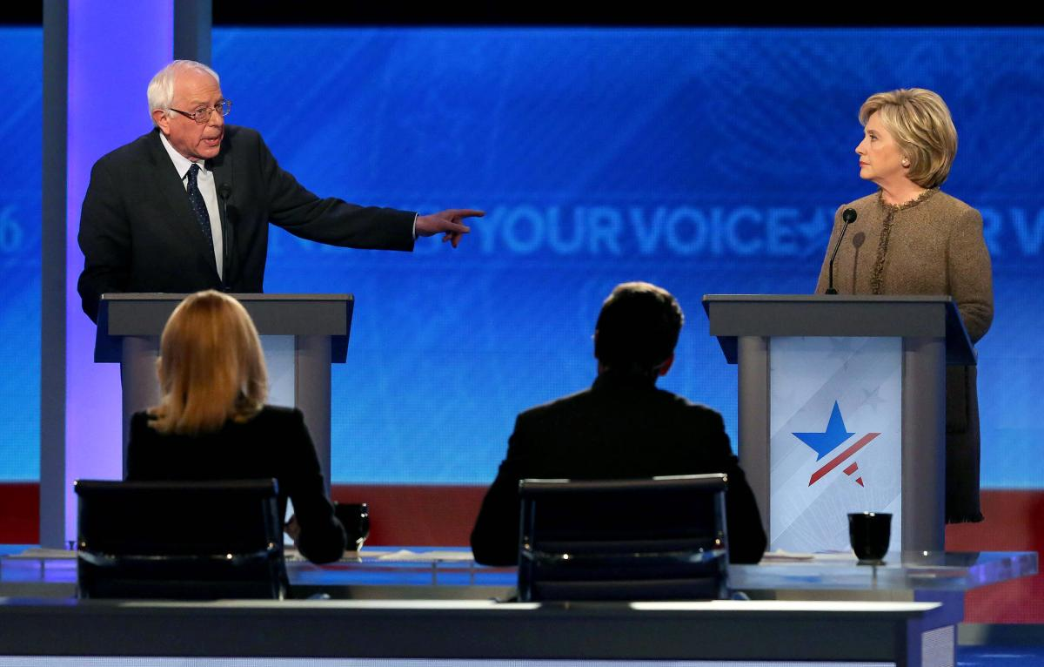
When you make your one minute statement, or your rebuttal, don’t just give us facts, or stories. Inform us how the facts and stories help to support your position, or to discredit the opposition’s position.
Just standing up and spouting off facts without context is not very effective. This image is courtesy of politifact.com.

Slide 16
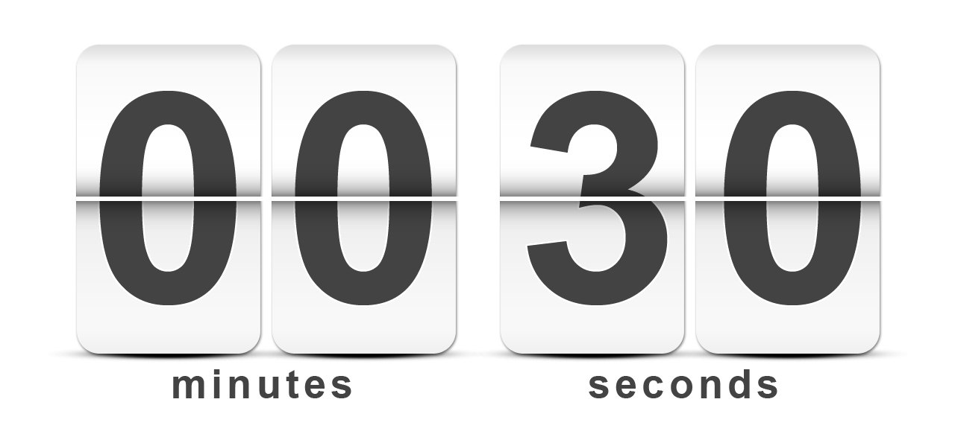
If you are giving the opening or closing statement, don’t be thrown off when the teacher tells you “30 Seconds.”
That is just a warning to let you know how much time that you have to complete your opening or closing statement. This image is courtesy of digitalgrowth.ca.

Slide 17
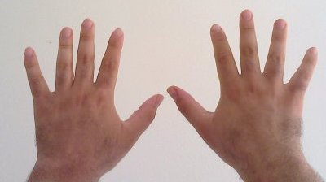
Another reason to keep your head up is if you are giving a one minute statement or rebuttal, the teacher will hold up 10 fingers when ten seconds are left, and count down.
Don’t panic, this is just for you to know to “wrap up” whatever statement that you are making. This image is courtesy of Wikimedia Commons.

Slide 18
When one finishes their statement or rebuttal, everyone will clap.
Of course how much everyone claps will depend on the quality of the statement or rebuttal. This image is courtesy of clipart.com.

Slide 19
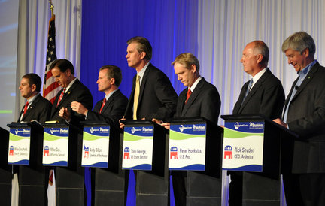
No debater is allowed to speak 3 times until everyone else on their team has had a chance to speak at least 1 time.
If there is extra time, we might have a chance for optional rebuttals, which are listed on your debate script. This image is courtesy of www.quazoo.com

Slide 20
While both sides speak, students should be taking notes on the debate script to help them during the time when it is their turn to speak.
At this point, one should be taking notes to help you in your rebuttal, and to respond to the other side’s rebuttal. Keep your head down, do not show much emotion. Do not show your opponent how effective or laughable their arguments are. You will let them know how laughable their arguments are during the rebuttal. This image is courtesy of hercampus.com.

Slide 21
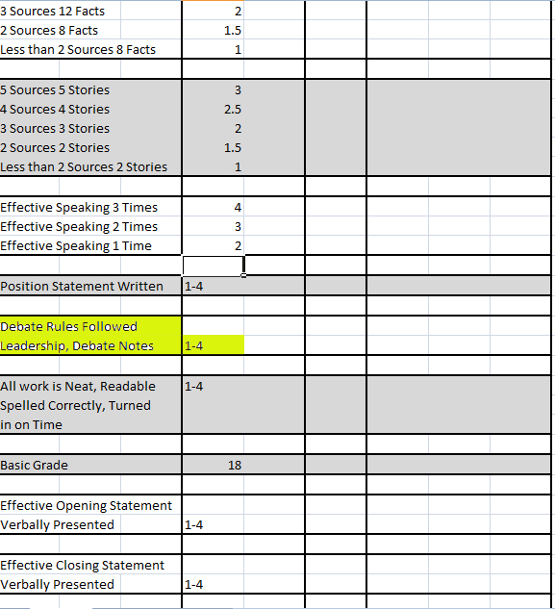
Another reason to keep your head down and take notes is that you are graded by how much you are paying attention during the debate.
One of the ways that your teacher can tell if you are paying attention is by the notes that you take. This image was created by Mr. Robert Housch.

Slide 22
Leadership is judged by how well you work with your fellow students in your huddles and how “engaged” you are in the huddles.
Don’t just sit back and let everyone else talk all the time. Take charge of your own learning, and if you have something to say, attempt to say it. You are graded on your participation, not only on what your group does. This image was created by Mr. Robert Housch.

Slide 23
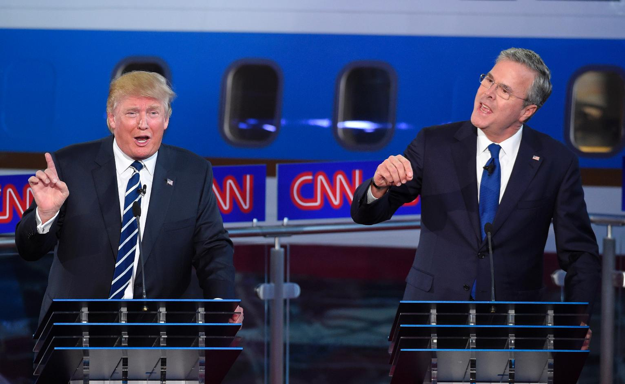
If someone says something outlandish, and/or controversial on the other side, you should answer that statement during the rebuttal. Don’t ignore it. Go after their statement.
If you ignore it, then you must think the statement is true, and the other side will receive credit for making a “point” during the debate. Don’t “talk past each other,” engage your opponent. This image is courtesy of usnews.com.

Slide 24
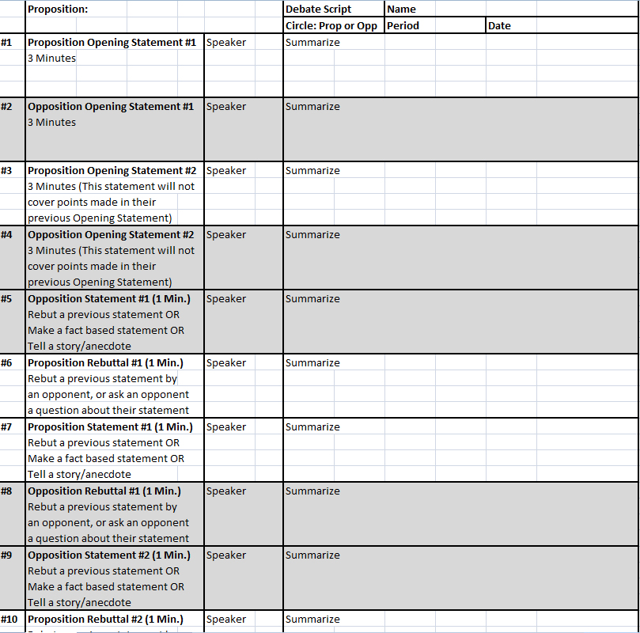
Use your Debate Scripts to understand exactly where we are in the debate, and what is being said in the debate.
The debate script shows step by step who is supposed to speak and when. The speakers and their subjects should also be on the board in front of you. Copy them down on the script. This image was created by Mr. Robert Housch.

Slide 25
Take your debate scripts with you into your “huddles.”
Taking notes during the huddles will help you to know exactly what you want to say during a rebuttal. This image is courtesy of memegenerator.net.

Slide 26
What to do in huddle before rebuttal:
1. Pick a speaker
2. What is the other side doing that you can attack?
3. Three items Rebuttal Speaker will use in their rebuttal
A.
B.
C.
Leadership isn’t just telling someone else to speak. You have to also give a rebuttal to receive leadership points.
During Rebuttal, a student should: A. Rebut a previous statement by an opponent OR
B. Ask a specific opponent a question about the opponent’s previous statement.
This image is courtesy of inanage.com.

Slide 27
The debate ends with closing statements from both sides.
The “Proposition” side speaks first, followed by the “Opposition” side. In the final huddle, the students will decide which student will represent them by giving the closing statement for their side. This image is courtesy of www2.humboldteducation.com

Slide 28
The students will objectively vote on who they believe won the debate.
Notice we are not saying who is right or wrong, but who we believe won the debate. This image is courtesy of www.satirecartoonists.com

Slide 29
The judges/moderators will objectively vote on who they believe won the debate.
Notice we are not saying who is right or wrong, but who we believe won the debate. This image is courtesy of mannuhn.deviantart.com.

Slide 30
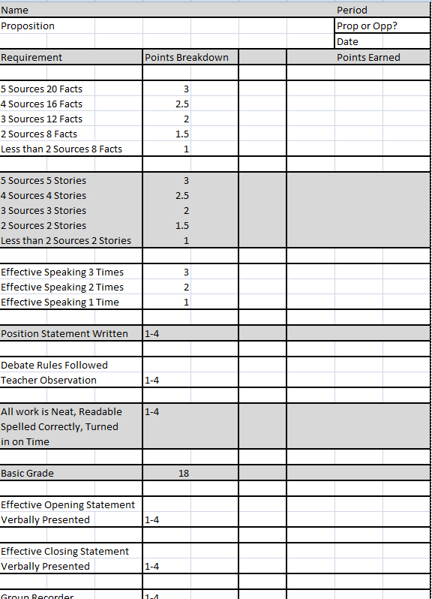
Your final grade for the debate will be placed on the Debate Rubric.
One may earn extra points by either giving the opening argument or the closing argument to their side of the debate. This image was created by Robert Housch.

Slide 31
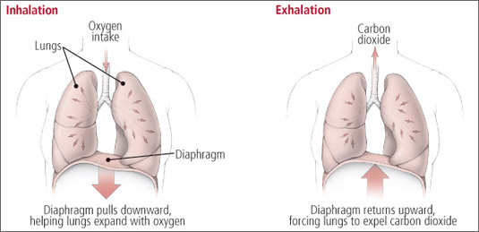
Take a deep breath and let it out slowly, a good debater is a relaxed debater.
Now start thinking clearly. This image is courtesy of harvard.edu.

Slide 32
More immigrants should be allowed in the United States.
This image is courtesy of usimmigrationjourney.com

Slide 33
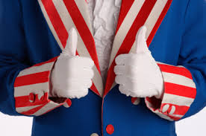
#1 Proposition Opening Statement #1 Approximately 3 Minutes
Each opening statement will include both side’s opinion, and a brief overview of the supporting evidence for those opinions. To understand an opponent’s weaknesses, one must understand their opinions and the source of their opinions. This image is courtesy of englin.net.

Slide 34
#2 Opposition Opening Statement #1 Approximately 3 Minutes
Each opening statement will include both side’s opinion, and a brief overview of the supporting evidence for those opinions. To understand an opponent’s weaknesses, one must understand their opinions and the source of their opinions. This image is courtesy of chicagofreedomforum.blog.spot.com.

Slide 35
#3 Proposition Opening Statement #2 Approximately 3 Minutes
Each opening statement will include both side’s opinion, and a brief overview of the supporting evidence for those opinions. To understand an opponent’s weaknesses, one must understand their opinions and the source of their opinions. This image is courtesy of englin.net.

Slide 36
#4 Opposition Opening Statement #2 Approximately 3 Minutes
Each opening statement will include both side’s opinion, and a brief overview of the supporting evidence for those opinions. To understand an opponent’s weaknesses, one must understand their opinions and the source of their opinions. This image is courtesy of chicagofreedomforum.blogspot.com.

Slide 37
The moderator will allow the students from each side to “huddle” for 45 seconds before they respond to the statement.
During the “huddle,” they will explain to each other the weaknesses of the other side, and what information that they must find to refute their opponent’s attack. They should make a rebuttal to one of the opposition’s previous statements. This image is courtesy of vistahumanities19.wikispaces.com

Slide 38
What to do in huddle before rebuttal:
1. Pick a speaker
2. What is the other side doing that you can attack?
3. Three items Rebuttal Speaker will use in their rebuttal
A.
B.
C.
Leadership isn’t just telling someone else to speak. You have to also give a rebuttal to receive leadership points.
During Rebuttal, a student should: A. Rebut a previous statement by an opponent OR
B. Ask a specific opponent a question about the opponent’s previous statement.
This image is courtesy of inanage.com.

Slide 39
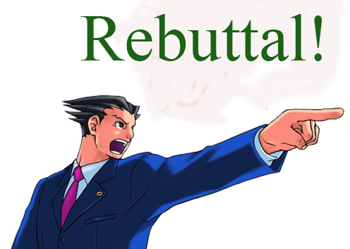
#5 Proposition Rebuttal to Opening Statements Approximately 1 Minute
During Rebuttal, a student should: A. Rebut a previous statement by an opponent OR
B. Ask a specific opponent a question about the opponent’s previous statement.
This image is courtesy of inanage.com.

Slide 40
#6 Opposition Rebuttal to Opening Statements Approximately 1 Minute
During Rebuttal, a student should: A. Rebut a previous statement by an opponent OR
B. Ask a specific opponent a question about the opponent’s previous statement.
This image is courtesy of keepcalm0matic.co.uk.

Slide 41
#7 Proposition Statement #1 Approximately 1 Minute
These statements can: A. Rebut a previous statement,
B. Make a fact based statement that you have already prepared.
C. Tell a story/anecdote that you have already prepared.
This image is courtesy of abcgreatpix.com.

Slide 42
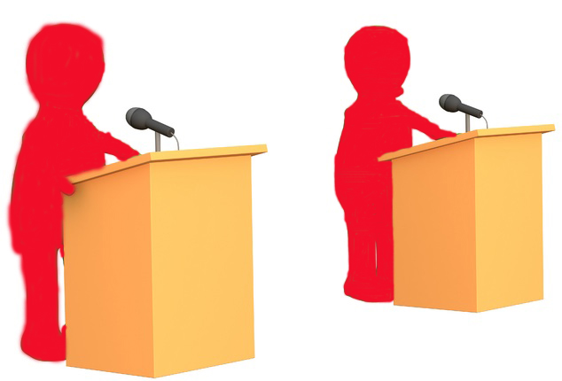
#8 Opposition Statement #1 Approximately 1 Minute
These statements can: A. Rebut a previous statement,
B. Make a fact based statement that you have already prepared.
C. Tell a story/anecdote that you have already prepared.
This image is courtesy of keepcalm0matic.co.uk.

Slide 43
#9 Proposition Statement #2 Approximately 1 Minute
These statements can: A. Rebut a previous statement,
B. Make a fact based statement that you have already prepared.
C. Tell a story/anecdote that you have already prepared.
This image is courtesy of abcgreatpix.com.

Slide 44
#10 Opposition Statement #2 Approximately 1 Minute
These statements can: A. Rebut a previous statement,
B. Make a fact based statement that you have already prepared.
C. Tell a story/anecdote that you have already prepared.
This image is courtesy of keepcalm0matic.co.uk.

Slide 45
The moderator will allow the students from each side to “huddle” for 45 seconds before they respond to the statement.
During the “huddle,” they will explain to each other the weaknesses of the other side, and what information that they must find to refute their opponent’s attack. They should make a rebuttal to one of the opposition’s previous statements. This image is courtesy of vistahumanities19.wikispaces.com

Slide 46
What to do in huddle before rebuttal:
1. Pick a speaker
2. What is the other side doing that you can attack?
3. Three items Rebuttal Speaker will use in their rebuttal
A.
B.
C.
Leadership isn’t just telling someone else to speak. You have to also give a rebuttal to receive leadership points.
During Rebuttal, a student should: A. Rebut a previous statement by an opponent OR
B. Ask a specific opponent a question about the opponent’s previous statement.
This image is courtesy of inanage.com.

Slide 47
#11 Proposition Rebuttal #1 & #2 Approximately 1 Minute
During Rebuttal, a student should: A. Rebut a previous statement by an opponent OR
B. Ask a specific opponent a question about the opponent’s previous statement.
This image is courtesy of inanage.com.

Slide 48
#12 Opposition Rebuttal #1 & #2 Approximately 1 Minute
During Rebuttal, a student should: A. Rebut a previous statement by an opponent OR
B. Ask a specific opponent a question about the opponent’s previous statement.
This image is courtesy of keepcalm0matic.co.uk.

Slide 49
#13 Proposition Statement #3 Approximately 1 Minute
These statements can: A. Rebut a previous statement,
B. Make a fact based statement that you have already prepared.
C. Tell a story/anecdote that you have already prepared.
This image is courtesy of abcgreatpix.com.

Slide 50
#14 Opposition Statement #3 Approximately 1 Minute
These statements can: A. Rebut a previous statement,
B. Make a fact based statement that you have already prepared.
C. Tell a story/anecdote that you have already prepared.
This image is courtesy of keepcalm0matic.co.uk.

Slide 51
#15 Proposition Statement #4 Approximately 1 Minute
These statements can: A. Rebut a previous statement,
B. Make a fact based statement that you have already prepared.
C. Tell a story/anecdote that you have already prepared.
This image is courtesy of abcgreatpix.com.

Slide 52
#16 Opposition Statement #4 Approximately 1 Minute
These statements can: A. Rebut a previous statement,
B. Make a fact based statement that you have already prepared.
C. Tell a story/anecdote that you have already prepared.
This image is courtesy of keepcalm0matic.co.uk.

Slide 53
The moderator will allow the students from each side to “huddle” for 45 seconds before they respond to the statement.
During the “huddle,” they will explain to each other the weaknesses of the other side, and what information that they must find to refute their opponent’s attack. They should make a rebuttal to one of the opposition’s previous statements. This image is courtesy of vistahumanities19.wikispaces.com

Slide 54
What to do in huddle before rebuttal:
1. Pick a speaker
2. What is the other side doing that you can attack?
3. Three items Rebuttal Speaker will use in their rebuttal
A.
B.
C.
Leadership isn’t just telling someone else to speak. You have to also give a rebuttal to receive leadership points.
During Rebuttal, a student should: A. Rebut a previous statement by an opponent OR
B. Ask a specific opponent a question about the opponent’s previous statement.
This image is courtesy of inanage.com.

Slide 55
#17 Proposition Rebuttal #3 & #4 Approximately 1 Minute
During Rebuttal, a student should: A. Rebut a previous statement by an opponent OR
B. Ask a specific opponent a question about the opponent’s previous statement.
This image is courtesy of inanage.com.

Slide 56
#18 Opposition Rebuttal #3 & #4 Approximately 1 Minute
During Rebuttal, a student should: A. Rebut a previous statement by an opponent OR
B. Ask a specific opponent a question about the opponent’s previous statement.
This image is courtesy of keepcalm0matic.co.uk.

Slide 57
#19 Proposition Statement #5 Approximately 1 Minute
These statements can: A. Rebut a previous statement,
B. Make a fact based statement that you have already prepared.
C. Tell a story/anecdote that you have already prepared.
This image is courtesy of abcgreatpix.com.

Slide 58
#20 Opposition Statement #5 Approximately 1 Minute
These statements can: A. Rebut a previous statement,
B. Make a fact based statement that you have already prepared.
C. Tell a story/anecdote that you have already prepared.
This image is courtesy of keepcalm0matic.co.uk.

Slide 59
#21 Proposition Statement #6 Approximately 1 Minute
These statements can: A. Rebut a previous statement,
B. Make a fact based statement that you have already prepared.
C. Tell a story/anecdote that you have already prepared.
This image is courtesy of abcgreatpix.com.

Slide 60
#22 Opposition Statement #6 Approximately 1 Minute
These statements can: A. Rebut a previous statement,
B. Make a fact based statement that you have already prepared.
C. Tell a story/anecdote that you have already prepared.
This image is courtesy of keepcalm0matic.co.uk.

Slide 61
The moderator will allow the students from each side to “huddle” for 45 seconds before they respond to the statement.
During the “huddle,” they will explain to each other the weaknesses of the other side, and what information that they must find to refute their opponent’s attack. They should make a rebuttal to one of the opposition’s previous statements. This image is courtesy of vistahumanities19.wikispaces.com

Slide 62
What to do in huddle before rebuttal:
1. Pick a speaker
2. What is the other side doing that you can attack?
3. Three items Rebuttal Speaker will use in their rebuttal
A.
B.
C.
Leadership isn’t just telling someone else to speak. You have to also give a rebuttal to receive leadership points.
During Rebuttal, a student should: A. Rebut a previous statement by an opponent OR
B. Ask a specific opponent a question about the opponent’s previous statement.
This image is courtesy of inanage.com.

Slide 63
#23 Proposition Rebuttal #5 & #6 Approximately 1 Minute
During Rebuttal, a student should: A. Rebut a previous statement by an opponent OR
B. Ask a specific opponent a question about the opponent’s previous statement.
This image is courtesy of inanage.com.

Slide 64
#24 Opposition Rebuttal #5 & #6 Approximately 1 Minute
During Rebuttal, a student should: A. Rebut a previous statement by an opponent OR
B. Ask a specific opponent a question about the opponent’s previous statement.
This image is courtesy of keepcalm0matic.co.uk.

Slide 65
#25 Proposition Statement #7 Approximately 1 Minute
These statements can: A. Rebut a previous statement,
B. Make a fact based statement that you have already prepared.
C. Tell a story/anecdote that you have already prepared.
This image is courtesy of abcgreatpix.com.

Slide 66
#26 Opposition Statement #7 Approximately 1 Minute
These statements can: A. Rebut a previous statement,
B. Make a fact based statement that you have already prepared.
C. Tell a story/anecdote that you have already prepared.
This image is courtesy of keepcalm0matic.co.uk.

Slide 67
#27 Proposition Statement #8 Approximately 1 Minute
These statements can: A. Rebut a previous statement,
B. Make a fact based statement that you have already prepared.
C. Tell a story/anecdote that you have already prepared.
This image is courtesy of abcgreatpix.com.

Slide 68
#28 Opposition Statement #8 Approximately 1 Minute
These statements can: A. Rebut a previous statement,
B. Make a fact based statement that you have already prepared.
C. Tell a story/anecdote that you have already prepared.
This image is courtesy of keepcalm0matic.co.uk.

Slide 69
The moderator will allow the students from each side to “huddle” for 45 seconds before they respond to the statement.
During the “huddle,” they will explain to each other the weaknesses of the other side, and what information that they must find to refute their opponent’s attack. They should make a rebuttal to one of the opposition’s previous statements. This image is courtesy of vistahumanities19.wikispaces.com

Slide 70
What to do in huddle before rebuttal:
1. Pick a speaker
2. What is the other side doing that you can attack?
3. Three items Rebuttal Speaker will use in their rebuttal
A.
B.
C.
Leadership isn’t just telling someone else to speak. You have to also give a rebuttal to receive leadership points.
During Rebuttal, a student should: A. Rebut a previous statement by an opponent OR
B. Ask a specific opponent a question about the opponent’s previous statement.
This image is courtesy of inanage.com.

Slide 71
#29 Proposition Rebuttal #7 & #8 Approximately 1 Minute
During Rebuttal, a student should: A. Rebut a previous statement by an opponent OR
B. Ask a specific opponent a question about the opponent’s previous statement.
This image is courtesy of inanage.com.

Slide 72
#30 Opposition Rebuttal #7 & #8 Approximately 1 Minute
During Rebuttal, a student should: A. Rebut a previous statement by an opponent OR
B. Ask a specific opponent a question about the opponent’s previous statement.
This image is courtesy of keepcalm0matic.co.uk.

Slide 73
#31 Proposition Statement #9 Approximately 1 Minute
These statements can: A. Rebut a previous statement,
B. Make a fact based statement that you have already prepared.
C. Tell a story/anecdote that you have already prepared.
This image is courtesy of abcgreatpix.com.

Slide 74
#32 Opposition Statement #9 Approximately 1 Minute
These statements can: A. Rebut a previous statement,
B. Make a fact based statement that you have already prepared.
C. Tell a story/anecdote that you have already prepared.
This image is courtesy of keepcalm0matic.co.uk.

Slide 75
#33 Proposition Statement #10 Approximately 1 Minute
These statements can: A. Rebut a previous statement,
B. Make a fact based statement that you have already prepared.
C. Tell a story/anecdote that you have already prepared.
This image is courtesy of abcgreatpix.com.

Slide 76
#34 Opposition Statement #10 Approximately 1 Minute
These statements can: A. Rebut a previous statement,
B. Make a fact based statement that you have already prepared.
C. Tell a story/anecdote that you have already prepared.
This image is courtesy of keepcalm0matic.co.uk.

Slide 77
The moderator will allow the students from each side to “huddle” for 45 seconds before they respond to the statement.
During the “huddle,” they will explain to each other the weaknesses of the other side, and what information that they must find to refute their opponent’s attack. They should make a rebuttal to one of the opposition’s previous statements. This image is courtesy of vistahumanities19.wikispaces.com

Slide 78
What to do in huddle before rebuttal:
1. Pick a speaker
2. What is the other side doing that you can attack?
3. Three items Rebuttal Speaker will use in their rebuttal
A.
B.
C.
Leadership isn’t just telling someone else to speak. You have to also give a rebuttal to receive leadership points.
During Rebuttal, a student should: A. Rebut a previous statement by an opponent OR
B. Ask a specific opponent a question about the opponent’s previous statement.
This image is courtesy of inanage.com.

Slide 79
#35 Proposition Rebuttal #9 & #10 Approximately 1 Minute
During Rebuttal, a student should: A. Rebut a previous statement by an opponent OR
B. Ask a specific opponent a question about the opponent’s previous statement.
This image is courtesy of inanage.com.

Slide 80
#36 Opposition Rebuttal #9 & #10 Approximately 1 Minute
During Rebuttal, a student should: A. Rebut a previous statement by an opponent OR
B. Ask a specific opponent a question about the opponent’s previous statement.
This image is courtesy of keepcalm0matic.co.uk.

Slide 81
#37 Proposition Statement #11 Approximately 1 Minute
These statements can: A. Rebut a previous statement,
B. Make a fact based statement that you have already prepared.
C. Tell a story/anecdote that you have already prepared.
This image is courtesy of abcgreatpix.com.

Slide 82
#38 Opposition Statement #11 Approximately 1 Minute
These statements can: A. Rebut a previous statement,
B. Make a fact based statement that you have already prepared.
C. Tell a story/anecdote that you have already prepared.
This image is courtesy of keepcalm0matic.co.uk.

Slide 83
#39 Proposition Statement #12 Approximately 1 Minute
These statements can: A. Rebut a previous statement,
B. Make a fact based statement that you have already prepared.
C. Tell a story/anecdote that you have already prepared.
This image is courtesy of abcgreatpix.com.

Slide 84
#40 Opposition Statement #12 Approximately 1 Minute
These statements can: A. Rebut a previous statement,
B. Make a fact based statement that you have already prepared.
C. Tell a story/anecdote that you have already prepared.
This image is courtesy of keepcalm0matic.co.uk.

Slide 85
The moderator will allow the students from each side to “huddle” for 45 seconds before they respond to the statement.
During the “huddle,” they will explain to each other the weaknesses of the other side, and what information that they must find to refute their opponent’s attack. They should make a rebuttal to one of the opposition’s previous statements. This image is courtesy of vistahumanities19.wikispaces.com

Slide 86
What to do in huddle before rebuttal:
1. Pick a speaker
2. What is the other side doing that you can attack?
3. Three items Rebuttal Speaker will use in their rebuttal
A.
B.
C.
Leadership isn’t just telling someone else to speak. You have to also give a rebuttal to receive leadership points.
During Rebuttal, a student should: A. Rebut a previous statement by an opponent OR
B. Ask a specific opponent a question about the opponent’s previous statement.
This image is courtesy of inanage.com.

Slide 87
#41 Proposition Rebuttal #11 & #12 Approximately 1 Minute
During Rebuttal, a student should: A. Rebut a previous statement by an opponent OR
B. Ask a specific opponent a question about the opponent’s previous statement.
This image is courtesy of inanage.com.

Slide 88
#42 Opposition Rebuttal #11 & #12 Approximately 1 Minute
During Rebuttal, a student should: A. Rebut a previous statement by an opponent OR
B. Ask a specific opponent a question about the opponent’s previous statement.
This image is courtesy of keepcalm0matic.co.uk.

Slide 89
The moderator will allow the students from each side to “huddle” for 45 seconds before they respond to the statement.
During the “huddle,” they will explain to each other the weaknesses of the other side, and what information that they must find to refute their opponent’s attack. They should make a rebuttal to one of the opposition’s previous statements. This image is courtesy of vistahumanities19.wikispaces.com

Slide 90
What to do in huddle before rebuttal:
1. Pick a speaker
2. What is the other side doing that you can attack?
3. Three items Rebuttal Speaker will use in their rebuttal
A.
B.
C.
Leadership isn’t just telling someone else to speak. You have to also give a rebuttal to receive leadership points.
During Rebuttal, a student should: A. Rebut a previous statement by an opponent OR
B. Ask a specific opponent a question about the opponent’s previous statement.
This image is courtesy of inanage.com.

Slide 91
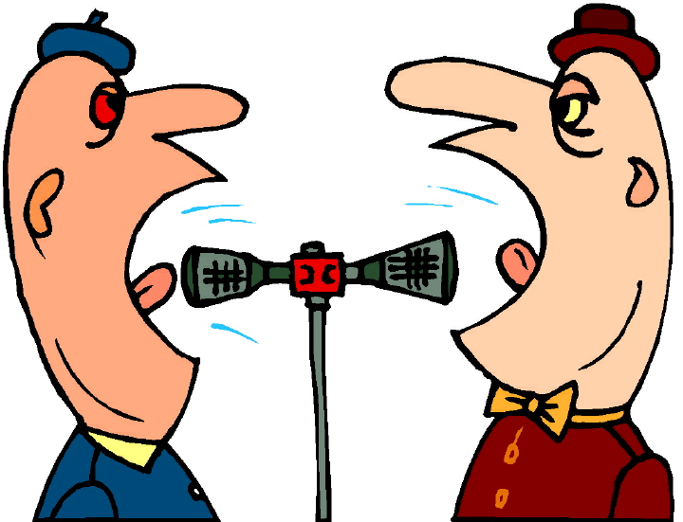
#43 Optional Rebuttal #1 Approximately 1 Minute
If there is time during the debate some students might want to speak more. They can rebut any previous statement from the other side. Priority is first given to those students who have only spoken one time. The next priority for this spot is for someone who has only spoken twice. The last priority for this spot is for someone who has spoken three times.
This image is courtesy of technode.com.

Slide 92
#44 Optional Rebuttal #2 Approximately 1 Minute
If there is time during the debate some students might want to speak more. They can rebut any previous statement from the other side. Priority is first given to those students who have only spoken one time. The next priority for this spot is for someone who has only spoken twice. The last priority for this spot is for someone who has spoken three times.
This image is courtesy of technode.com.

Slide 93
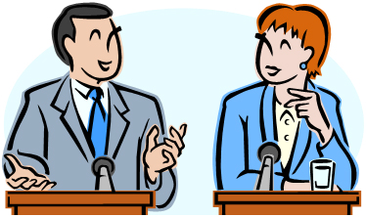
#45 Proposition Closing Statement #1 Approximately 3 Minutes
You will restate your side’s opinion with strong supporting evidence, not the opposition’s opinion. Each student should have a closing statement ready in case they are called upon to make a closing statement. This image is courtesy of scienceskepticism.blogspot.com.

Slide 94
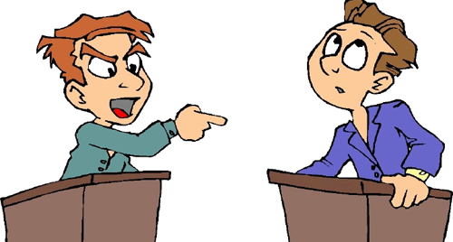
#46 Opposition Closing Statement #1 Approximately 3 Minutes
You will restate your side’s opinion with strong supporting evidence, not the opposition’s opinion. Each student should have a closing statement ready in case they are called upon to make a closing statement. This image is courtesy of jewishtribune.ca.

Slide 95
#47 Proposition Closing Statement #2 (if needed) Approximately 3 Minutes
You will restate your side’s opinion with strong supporting evidence, not the opposition’s opinion. Each student should have a closing statement ready in case they are called upon to make a closing statement. This image is courtesy of scienceskepticism.blogspot.com.

Slide 96
#48 Opposition Closing Statement #2 (if needed) Approximately 3 Minutes
You will restate your side’s opinion with strong supporting evidence, not the opposition’s opinion. Each student should have a closing statement ready in case they are called upon to make a closing statement. This image is courtesy of jewishtribune.ca.

Slide 97
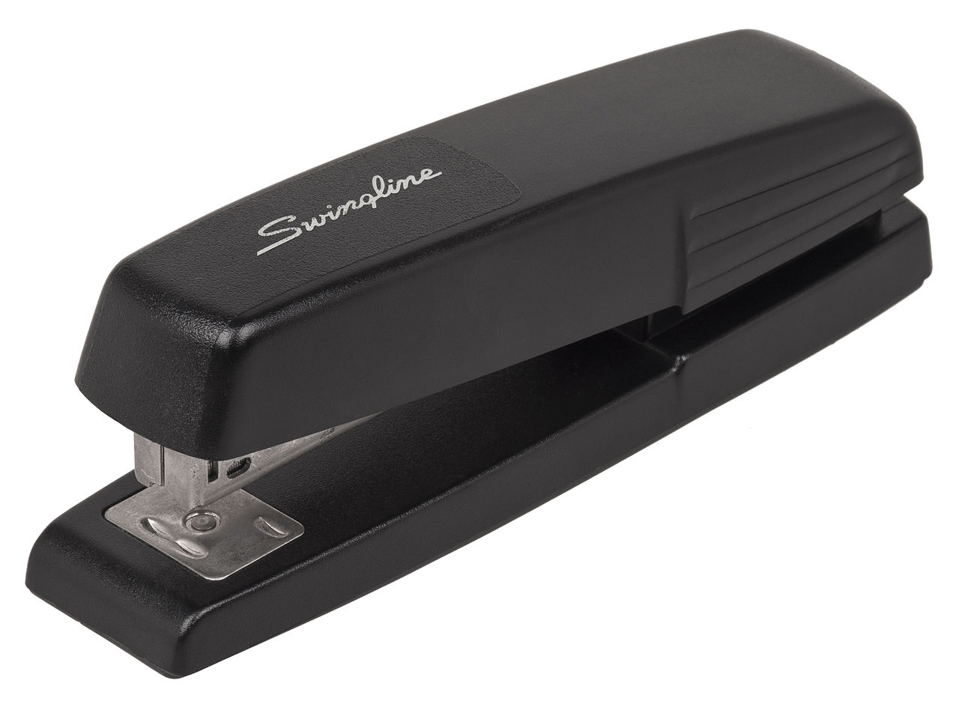
Staple your Rubric packet/Template to your Debate Script Packet, and place it in the white basket.
Make sure your name is on the rubric. This image is courtesy of Wikimedia Commons.

Slide 98
The students will objectively vote on who they believe won the debate.
Notice we are not saying who is right or wrong, but who we believe won the debate. This image is courtesy of www.satirecartoonists.com

Slide 99
You should have received a small piece of paper. Write on it who you think won the debate, give 3 reasons why you think that side won the debate, fold it in half, and place it in the box on the white table.
Notice that you are not voting who is right or wrong on this subject, but on which side you believe won the debate. This image is courtesy of nodiman.en.made-in-china.com

Slide 100
The judges/moderators will objectively vote on who they believe won the debate.
Notice we are not saying who is right or wrong, but who we believe won the debate. This image is courtesy of mannuhn.deviantart.com.

Slide 101
Your final grade for the debate will be placed on the Debate Rubric.
One may earn extra points by either giving the opening argument or the closing argument to their side of the debate. This image was created by Robert Housch.

