Slide 1
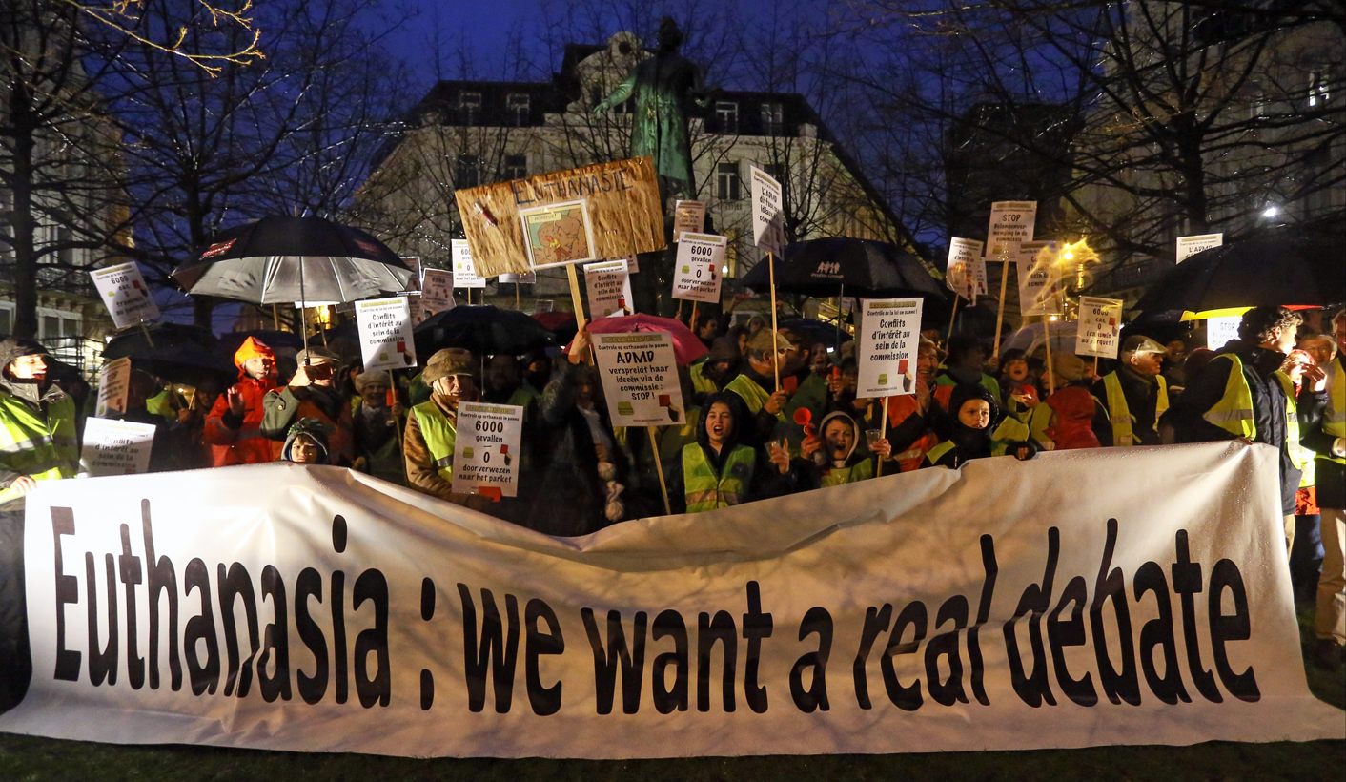
Euthanasia (physician-assisted suicide) should be legal in the United States.
This image is courtesy of dailymaverick.co.za

Slide 2
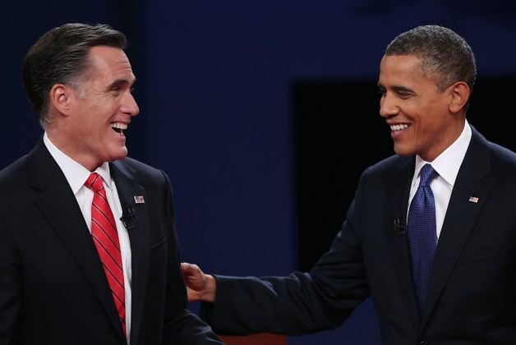
Debate Rules:
Be Polite and Courteous
This image is courtesy of www.sfgate.com

Slide 3
Debate Rules:
Be Polite and Courteous
Listen Carefully to Both Sides

Slide 4
Debate Rules:
Be Polite and Courteous
Listen Carefully to Both Sides
Be Respectful and Supportive of your fellow students

Slide 5
Debate Rules:
Be Polite and Courteous
Listen Carefully to Both Sides
Be Respectful and Supportive of your fellow students
Avoid making inappropriate noises

Slide 6
Debate Rules:
Be Polite and Courteous
Listen Carefully to Both Sides
Be Respectful and Supportive of your fellow students
Avoid making inappropriate noises
Speak only when recognized by the moderator

Slide 7
Debate Rules:
Be Polite and Courteous
Listen Carefully to Both Sides
Be Respectful and Supportive of your fellow students
Avoid making inappropriate noises
Speak only when recognized by the moderator
Allow others to express their opinions

Slide 8
Debate Rules:
Be Polite and Courteous
Listen Carefully to Both Sides
Be Respectful and Supportive of your fellow students
Avoid making inappropriate noises
Speak only when recognized by the moderator
Allow others to express their opinions
Do not try to talk all the time without giving someone else their turn

Slide 9
Debate Rules:
Be Polite and Courteous
Listen Carefully to Both Sides
Be Respectful and Supportive of your fellow students
Avoid making inappropriate noises
Speak only when recognized by the moderator
Allow others to express their opinions
Do not try to talk all the time without giving someone else their turn
Use grammatically correct language (don’t sound like you're uneducated)

Slide 10
Debate Rules:
Be Polite and Courteous
Listen Carefully to Both Sides
Be Respectful and Supportive of your fellow students
Avoid making inappropriate noises
Speak only when recognized by the moderator
Allow others to express their opinions
Do not try to talk all the time without giving someone else their turn
Use grammatically correct language (don’t sound like you're uneducated)
Speak clearly, slowly, and loud enough to be heard by the audience

Slide 11
Debate Rules:
Be Polite and Courteous
Listen Carefully to Both Sides
Be Respectful and Supportive of your fellow students
Avoid making inappropriate noises
Speak only when recognized by the moderator
Allow others to express their opinions
Do not try to talk all the time without giving someone else their turn
Use grammatically correct language (don’t sound like you're uneducated)
Speak clearly, slowly, and loud enough to be heard by the audience
Speak with passion and excitement

Slide 12
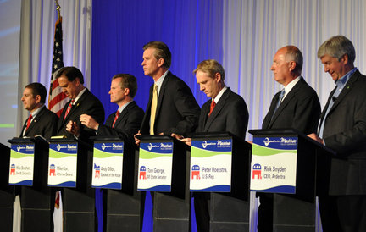
After a student speaks 2 times, they will not be allowed to speak again until everyone else on their team has had a chance to speak at least 1 time.
This image is courtesy of www.quazoo.com

Slide 13
While both sides speak, students should be taking notes on the debate script to help them during the time when it is their turn to speak.
At this point, one should be taking notes to help you in your rebuttal, and to respond to the other side’s rebuttal. Keep your head down, do not show much emotion. Do not show your opponent how effective or laughable their arguments are. This image is courtesy of hercampus.com.

Slide 14
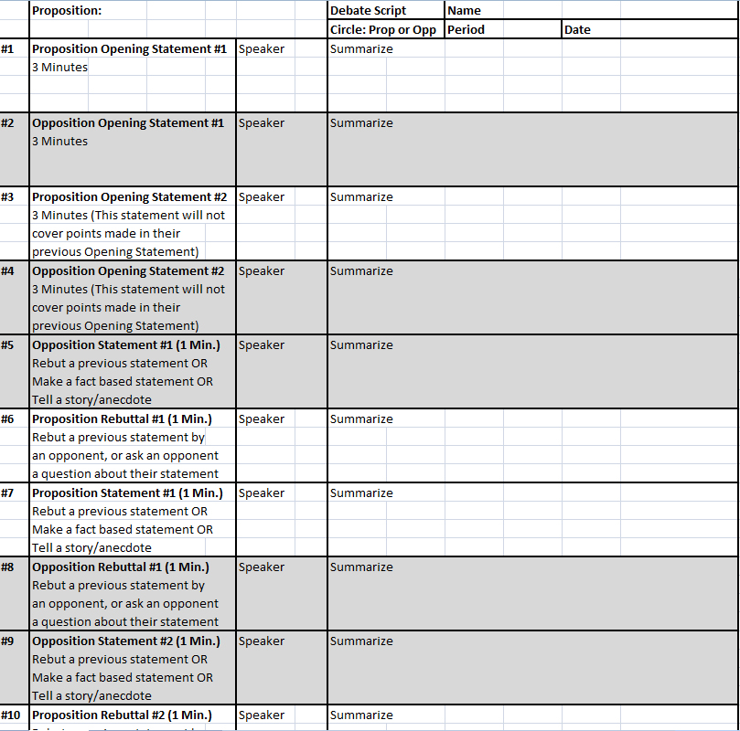
Use your Debate Scripts to understand exactly where we are in the debate, and what is being said in the debate.
The debate script shows step by step who is supposed to speak and when. First put your Name, Period, and Date on the script. This image was created by Mr. Robert Housch.

Slide 15
The debate ends with closing statements from both sides.
The “Proposition” side speaks first, followed by the “Opposition” side. In the final huddle, the students will decide which student will represent them by giving the closing statement for their side. This image is courtesy of www2.humboldteducation.com

Slide 16
The students will objectively vote on who they believe won the debate.
Notice we are not saying who is right or wrong, but who we believe won the debate. This image is courtesy of www.satirecartoonists.com

Slide 17
The judges/moderators will objectively vote on who they believe won the debate.
Notice we are not saying who is right or wrong, but who we believe won the debate. This image is courtesy of mannuhn.deviantart.com.

Slide 18
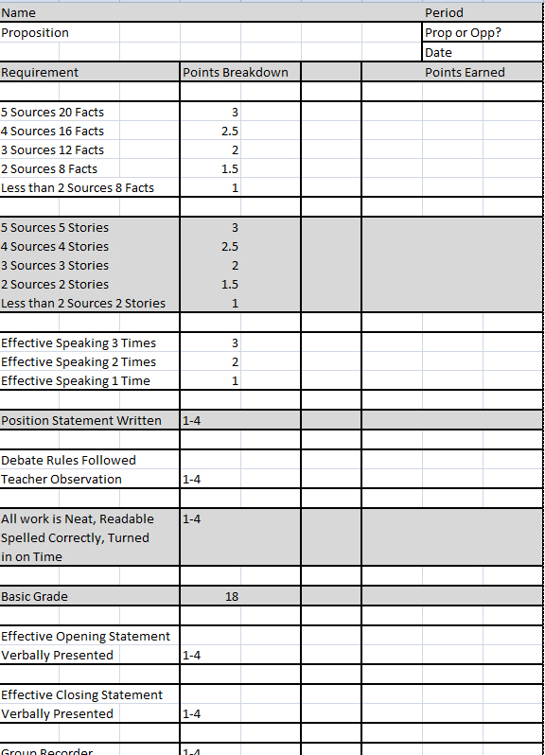
Your final grade for the debate will be placed on the Debate Rubric.
One may earn extra points by either giving the opening argument or the closing argument to their side of the debate. This image was created by Robert Housch.

Slide 19
Euthanasia (physician-assisted suicide) should be legal in the United States.
This image is courtesy of dailymaverick.co.za

Slide 20
#1 Proposition Opening Statement #1 Approximately 3 Minutes
Each opening statement will include both side’s opinion, and a brief overview of the supporting evidence for those opinions. To understand an opponent’s weaknesses, one must understand their opinions and the source of their opinions. This image is courtesy of englin.net.

Slide 21
#2 Opposition Opening Statement #1 Approximately 3 Minutes
Each opening statement will include both side’s opinion, and a brief overview of the supporting evidence for those opinions. To understand an opponent’s weaknesses, one must understand their opinions and the source of their opinions. This image is courtesy of chicagofreedomforum.blog.spot.com.

Slide 22
#3 Proposition Opening Statement #2 Approximately 3 Minutes
Each opening statement will include both side’s opinion, and a brief overview of the supporting evidence for those opinions. To understand an opponent’s weaknesses, one must understand their opinions and the source of their opinions. This image is courtesy of englin.net.

Slide 23
#4 Opposition Opening Statement #2 Approximately 3 Minutes
Each opening statement will include both side’s opinion, and a brief overview of the supporting evidence for those opinions. To understand an opponent’s weaknesses, one must understand their opinions and the source of their opinions. This image is courtesy of chicagofreedomforum.blogspot.com.

Slide 24
The moderator will allow the students from each side to “huddle” for 45 seconds before they respond to the statement.
During the “huddle,” they will explain to each other the weaknesses of the other side, and what information that they must find to refute their opponent’s attack. They should make a rebuttal to one of the opposition’s previous statements. This image is courtesy of vistahumanities19.wikispaces.com

Slide 25
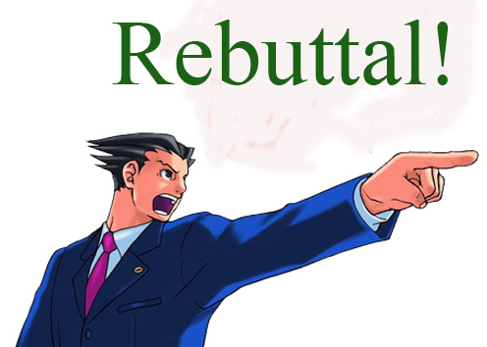
#5 Proposition Rebuttal to Opening Statements Approximately 1 Minute
During Rebuttal, a student should: A. Rebut a previous statement by an opponent OR
B. Ask a specific opponent a question about the opponent’s previous statement.
This image is courtesy of inanage.com.

Slide 26
#6 Opposition Rebuttal to Opening Statements Approximately 1 Minute
During Rebuttal, a student should: A. Rebut a previous statement by an opponent OR
B. Ask a specific opponent a question about the opponent’s previous statement.
This image is courtesy of keepcalm0matic.co.uk.

Slide 27
#7 Proposition Statement #1 Approximately 1 Minute
These statements can: A. Rebut a previous statement,
B. Make a fact based statement that you have already prepared.
C. Tell a story/anecdote that you have already prepared.
This image is courtesy of abcgreatpix.com.

Slide 28
#8 Opposition Statement #1 Approximately 1 Minute
These statements can: A. Rebut a previous statement,
B. Make a fact based statement that you have already prepared.
C. Tell a story/anecdote that you have already prepared.
This image is courtesy of keepcalm0matic.co.uk.

Slide 29
#9 Proposition Statement #2 Approximately 1 Minute
These statements can: A. Rebut a previous statement,
B. Make a fact based statement that you have already prepared.
C. Tell a story/anecdote that you have already prepared.
This image is courtesy of abcgreatpix.com.

Slide 30
#10 Opposition Statement #2 Approximately 1 Minute
These statements can: A. Rebut a previous statement,
B. Make a fact based statement that you have already prepared.
C. Tell a story/anecdote that you have already prepared.
This image is courtesy of keepcalm0matic.co.uk.

Slide 31
The moderator will allow the students from each side to “huddle” for 45 seconds before they respond to the statement.
During the “huddle,” they will explain to each other the weaknesses of the other side, and what information that they must find to refute their opponent’s attack. They should make a rebuttal to one of the opposition’s previous statements. This image is courtesy of vistahumanities19.wikispaces.com

Slide 32
#11 Proposition Rebuttal #1 & #2 Approximately 1 Minute
During Rebuttal, a student should: A. Rebut a previous statement by an opponent OR
B. Ask a specific opponent a question about the opponent’s previous statement.
This image is courtesy of inanage.com.

Slide 33
#12 Opposition Rebuttal #1 & #2 Approximately 1 Minute
During Rebuttal, a student should: A. Rebut a previous statement by an opponent OR
B. Ask a specific opponent a question about the opponent’s previous statement.
This image is courtesy of keepcalm0matic.co.uk.

Slide 34
#13 Proposition Statement #3 Approximately 1 Minute
These statements can: A. Rebut a previous statement,
B. Make a fact based statement that you have already prepared.
C. Tell a story/anecdote that you have already prepared.
This image is courtesy of abcgreatpix.com.

Slide 35
#14 Opposition Statement #3 Approximately 1 Minute
These statements can: A. Rebut a previous statement,
B. Make a fact based statement that you have already prepared.
C. Tell a story/anecdote that you have already prepared.
This image is courtesy of keepcalm0matic.co.uk.

Slide 36
#15 Proposition Statement #4 Approximately 1 Minute
These statements can: A. Rebut a previous statement,
B. Make a fact based statement that you have already prepared.
C. Tell a story/anecdote that you have already prepared.
This image is courtesy of abcgreatpix.com.

Slide 37
#16 Opposition Statement #4 Approximately 1 Minute
These statements can: A. Rebut a previous statement,
B. Make a fact based statement that you have already prepared.
C. Tell a story/anecdote that you have already prepared.
This image is courtesy of keepcalm0matic.co.uk.

Slide 38
The moderator will allow the students from each side to “huddle” for 45 seconds before they respond to the statement.
During the “huddle,” they will explain to each other the weaknesses of the other side, and what information that they must find to refute their opponent’s attack. They should make a rebuttal to one of the opposition’s previous statements. This image is courtesy of vistahumanities19.wikispaces.com

Slide 39
#17 Proposition Rebuttal #3 & #4 Approximately 1 Minute
During Rebuttal, a student should: A. Rebut a previous statement by an opponent OR
B. Ask a specific opponent a question about the opponent’s previous statement.
This image is courtesy of inanage.com.

Slide 40
#18 Opposition Rebuttal #3 & #4 Approximately 1 Minute
During Rebuttal, a student should: A. Rebut a previous statement by an opponent OR
B. Ask a specific opponent a question about the opponent’s previous statement.
This image is courtesy of keepcalm0matic.co.uk.

Slide 41
#19 Proposition Statement #5 Approximately 1 Minute
These statements can: A. Rebut a previous statement,
B. Make a fact based statement that you have already prepared.
C. Tell a story/anecdote that you have already prepared.
This image is courtesy of abcgreatpix.com.

Slide 42
#20 Opposition Statement #5 Approximately 1 Minute
These statements can: A. Rebut a previous statement,
B. Make a fact based statement that you have already prepared.
C. Tell a story/anecdote that you have already prepared.
This image is courtesy of keepcalm0matic.co.uk.

Slide 43
#21 Proposition Statement #6 Approximately 1 Minute
These statements can: A. Rebut a previous statement,
B. Make a fact based statement that you have already prepared.
C. Tell a story/anecdote that you have already prepared.
This image is courtesy of abcgreatpix.com.

Slide 44
#22 Opposition Statement #6 Approximately 1 Minute
These statements can: A. Rebut a previous statement,
B. Make a fact based statement that you have already prepared.
C. Tell a story/anecdote that you have already prepared.
This image is courtesy of keepcalm0matic.co.uk.

Slide 45
The moderator will allow the students from each side to “huddle” for 45 seconds before they respond to the statement.
During the “huddle,” they will explain to each other the weaknesses of the other side, and what information that they must find to refute their opponent’s attack. They should make a rebuttal to one of the opposition’s previous statements. This image is courtesy of vistahumanities19.wikispaces.com

Slide 46
#23 Proposition Rebuttal #5 & #6 Approximately 1 Minute
During Rebuttal, a student should: A. Rebut a previous statement by an opponent OR
B. Ask a specific opponent a question about the opponent’s previous statement.
This image is courtesy of inanage.com.

Slide 47
#24 Opposition Rebuttal #5 & #6 Approximately 1 Minute
During Rebuttal, a student should: A. Rebut a previous statement by an opponent OR
B. Ask a specific opponent a question about the opponent’s previous statement.
This image is courtesy of keepcalm0matic.co.uk.

Slide 48
#25 Proposition Statement #7 Approximately 1 Minute
These statements can: A. Rebut a previous statement,
B. Make a fact based statement that you have already prepared.
C. Tell a story/anecdote that you have already prepared.
This image is courtesy of abcgreatpix.com.

Slide 49
#26 Opposition Statement #7 Approximately 1 Minute
These statements can: A. Rebut a previous statement,
B. Make a fact based statement that you have already prepared.
C. Tell a story/anecdote that you have already prepared.
This image is courtesy of keepcalm0matic.co.uk.

Slide 50
#27 Proposition Statement #8 Approximately 1 Minute
These statements can: A. Rebut a previous statement,
B. Make a fact based statement that you have already prepared.
C. Tell a story/anecdote that you have already prepared.
This image is courtesy of abcgreatpix.com.

Slide 51
#28 Opposition Statement #8 Approximately 1 Minute
These statements can: A. Rebut a previous statement,
B. Make a fact based statement that you have already prepared.
C. Tell a story/anecdote that you have already prepared.
This image is courtesy of keepcalm0matic.co.uk.

Slide 52
The moderator will allow the students from each side to “huddle” for 45 seconds before they respond to the statement.
During the “huddle,” they will explain to each other the weaknesses of the other side, and what information that they must find to refute their opponent’s attack. They should make a rebuttal to one of the opposition’s previous statements. This image is courtesy of vistahumanities19.wikispaces.com

Slide 53
#29 Proposition Rebuttal #7 & #8 Approximately 1 Minute
During Rebuttal, a student should: A. Rebut a previous statement by an opponent OR
B. Ask a specific opponent a question about the opponent’s previous statement.
This image is courtesy of inanage.com.

Slide 54
#30 Opposition Rebuttal #7 & #8 Approximately 1 Minute
During Rebuttal, a student should: A. Rebut a previous statement by an opponent OR
B. Ask a specific opponent a question about the opponent’s previous statement.
This image is courtesy of keepcalm0matic.co.uk.

Slide 55
#31 Proposition Statement #9 Approximately 1 Minute
These statements can: A. Rebut a previous statement,
B. Make a fact based statement that you have already prepared.
C. Tell a story/anecdote that you have already prepared.
This image is courtesy of abcgreatpix.com.

Slide 56
#32 Opposition Statement #9 Approximately 1 Minute
These statements can: A. Rebut a previous statement,
B. Make a fact based statement that you have already prepared.
C. Tell a story/anecdote that you have already prepared.
This image is courtesy of keepcalm0matic.co.uk.

Slide 57
#33 Proposition Statement #10 Approximately 1 Minute
These statements can: A. Rebut a previous statement,
B. Make a fact based statement that you have already prepared.
C. Tell a story/anecdote that you have already prepared.
This image is courtesy of abcgreatpix.com.

Slide 58
#34 Opposition Statement #10 Approximately 1 Minute
These statements can: A. Rebut a previous statement,
B. Make a fact based statement that you have already prepared.
C. Tell a story/anecdote that you have already prepared.
This image is courtesy of keepcalm0matic.co.uk.

Slide 59
The moderator will allow the students from each side to “huddle” for 45 seconds before they respond to the statement.
During the “huddle,” they will explain to each other the weaknesses of the other side, and what information that they must find to refute their opponent’s attack. They should make a rebuttal to one of the opposition’s previous statements. This image is courtesy of vistahumanities19.wikispaces.com

Slide 60
#35 Proposition Rebuttal #9 & #10 Approximately 1 Minute
During Rebuttal, a student should: A. Rebut a previous statement by an opponent OR
B. Ask a specific opponent a question about the opponent’s previous statement.
This image is courtesy of inanage.com.

Slide 61
#36 Opposition Rebuttal #9 & #10 Approximately 1 Minute
During Rebuttal, a student should: A. Rebut a previous statement by an opponent OR
B. Ask a specific opponent a question about the opponent’s previous statement.
This image is courtesy of keepcalm0matic.co.uk.

Slide 62
#37 Proposition Statement #11 Approximately 1 Minute
These statements can: A. Rebut a previous statement,
B. Make a fact based statement that you have already prepared.
C. Tell a story/anecdote that you have already prepared.
This image is courtesy of abcgreatpix.com.

Slide 63
#38 Opposition Statement #11 Approximately 1 Minute
These statements can: A. Rebut a previous statement,
B. Make a fact based statement that you have already prepared.
C. Tell a story/anecdote that you have already prepared.
This image is courtesy of keepcalm0matic.co.uk.

Slide 64
#39 Proposition Statement #12 Approximately 1 Minute
These statements can: A. Rebut a previous statement,
B. Make a fact based statement that you have already prepared.
C. Tell a story/anecdote that you have already prepared.
This image is courtesy of abcgreatpix.com.

Slide 65
#40 Opposition Statement #12 Approximately 1 Minute
These statements can: A. Rebut a previous statement,
B. Make a fact based statement that you have already prepared.
C. Tell a story/anecdote that you have already prepared.
This image is courtesy of keepcalm0matic.co.uk.

Slide 66
The moderator will allow the students from each side to “huddle” for 45 seconds before they respond to the statement.
During the “huddle,” they will explain to each other the weaknesses of the other side, and what information that they must find to refute their opponent’s attack. They should make a rebuttal to one of the opposition’s previous statements. This image is courtesy of vistahumanities19.wikispaces.com

Slide 67
#41 Proposition Rebuttal #11 & #12 Approximately 1 Minute
During Rebuttal, a student should: A. Rebut a previous statement by an opponent OR
B. Ask a specific opponent a question about the opponent’s previous statement.
This image is courtesy of inanage.com.

Slide 68
#42 Opposition Rebuttal #11 & #12 Approximately 1 Minute
During Rebuttal, a student should: A. Rebut a previous statement by an opponent OR
B. Ask a specific opponent a question about the opponent’s previous statement.
This image is courtesy of keepcalm0matic.co.uk.

Slide 69
The moderator will allow the students from each side to “huddle” for 45 seconds before they respond to the statement.
During the “huddle,” they will explain to each other the weaknesses of the other side, and what information that they must find to refute their opponent’s attack. They should make a rebuttal to one of the opposition’s previous statements. This image is courtesy of vistahumanities19.wikispaces.com

Slide 70
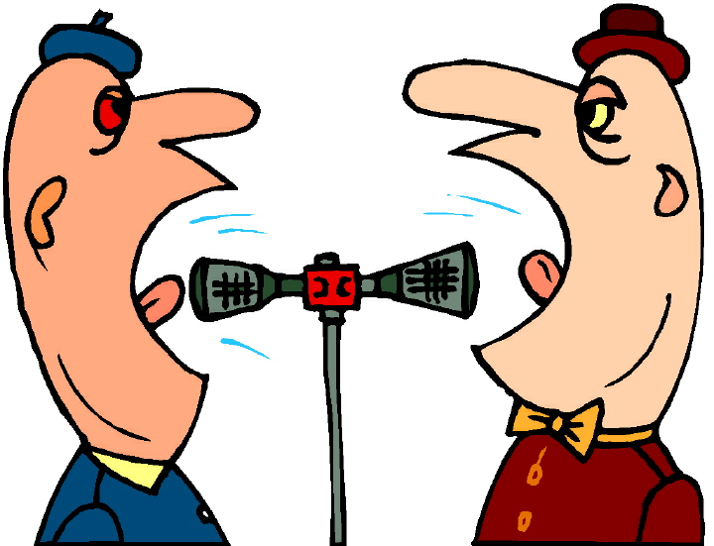
#43 Optional Rebuttal #1 Approximately 1 Minute
If there is time during the debate some students might want to speak more. They can rebut any previous statement from the other side. Priority is first given to those students who have only spoken one time. The next priority for this spot is for someone who has only spoken twice. The last priority for this spot is for someone who has spoken three times.
This image is courtesy of technode.com.

Slide 71
#44 Optional Rebuttal #2 Approximately 1 Minute
If there is time during the debate some students might want to speak more. They can rebut any previous statement from the other side. Priority is first given to those students who have only spoken one time. The next priority for this spot is for someone who has only spoken twice. The last priority for this spot is for someone who has spoken three times.
This image is courtesy of technode.com.

Slide 72
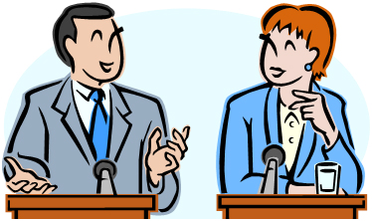
#45 Proposition Closing Statement #1 Approximately 3 Minutes
You will restate your side’s opinion with strong supporting evidence, not the opposition’s opinion. Each student should have a closing statement ready in case they are called upon to make a closing statement. This image is courtesy of scienceskepticism.blogspot.com.

Slide 73
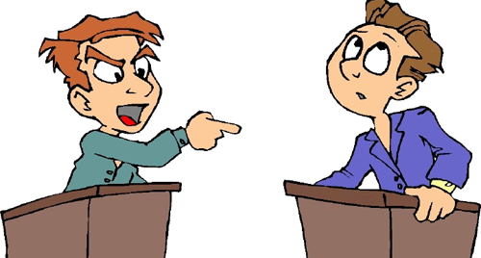
#46 Opposition Closing Statement #1 Approximately 3 Minutes
You will restate your side’s opinion with strong supporting evidence, not the opposition’s opinion. Each student should have a closing statement ready in case they are called upon to make a closing statement. This image is courtesy of jewishtribune.ca.

Slide 74
#47 Proposition Closing Statement #2 (if needed) Approximately 3 Minutes
You will restate your side’s opinion with strong supporting evidence, not the opposition’s opinion. Each student should have a closing statement ready in case they are called upon to make a closing statement. This image is courtesy of scienceskepticism.blogspot.com.

Slide 75
#48 Opposition Closing Statement #2 (if needed) Approximately 3 Minutes
You will restate your side’s opinion with strong supporting evidence, not the opposition’s opinion. Each student should have a closing statement ready in case they are called upon to make a closing statement. This image is courtesy of jewishtribune.ca.

Slide 76
The students will objectively vote on who they believe won the debate.
Notice we are not saying who is right or wrong, but who we believe won the debate. This image is courtesy of www.satirecartoonists.com

Slide 77
The judges/moderators will objectively vote on who they believe won the debate.
Notice we are not saying who is right or wrong, but who we believe won the debate. This image is courtesy of mannuhn.deviantart.com.

Slide 78
Your final grade for the debate will be placed on the Debate Rubric.
One may earn extra points by either giving the opening argument or the closing argument to their side of the debate. This image was created by Robert Housch.

