Slide 1
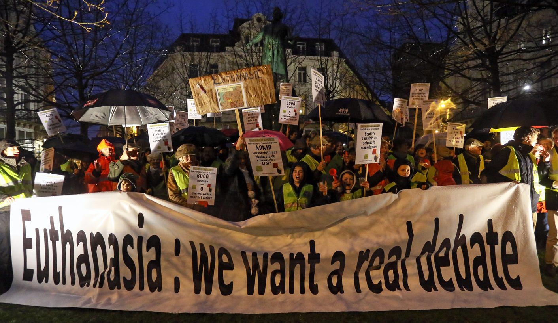
Euthanasia (physician-assisted suicide) should be legal in the United States.
This image is courtesy of dailymaverick.co.za

Slide 2
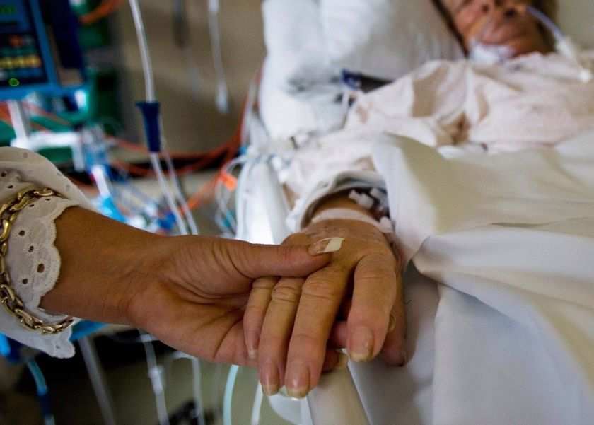
Euthanasia, sometimes called “mercy killing” is the act of putting someone to death painlessly, or allowing them to die.
This image is courtesy of statisticbrain.com.

Slide 3
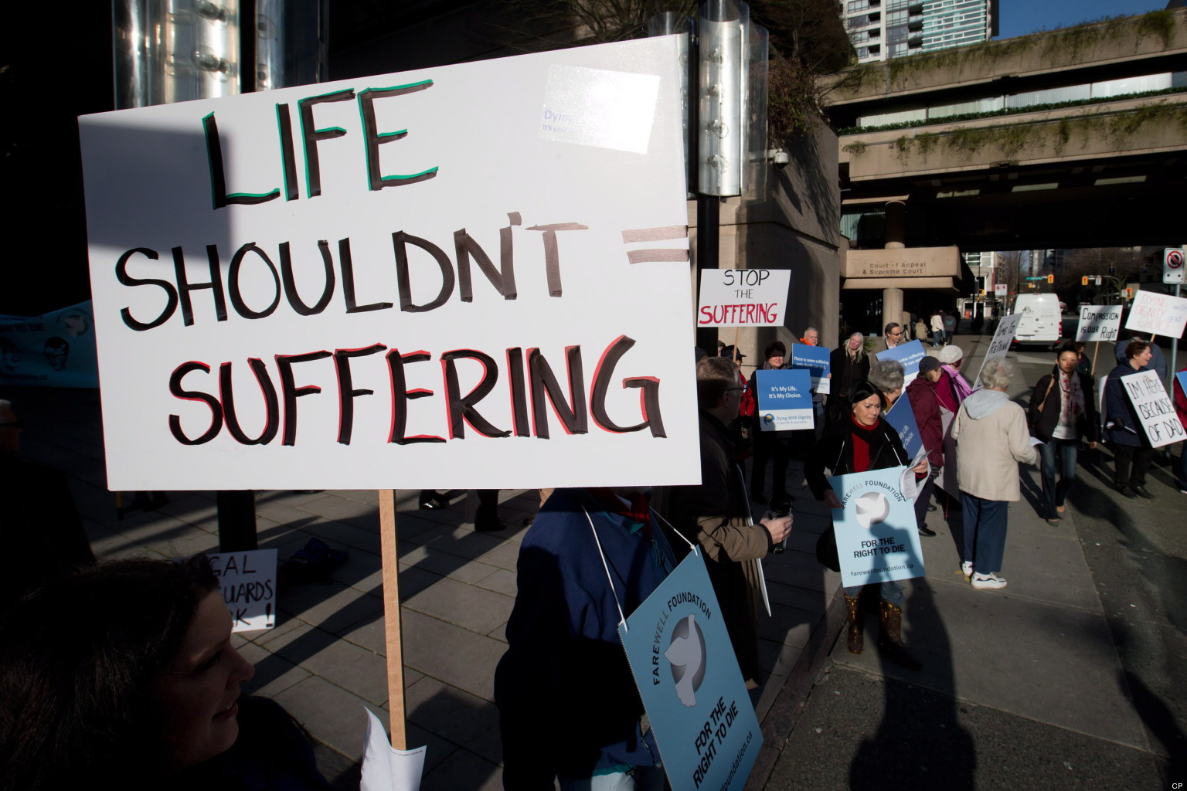
Sometimes euthanasia is accomplished by withholding extreme medical measures, such as a person suffering from an incurable, especially a painful, disease of condition.
This image is courtesy of huffingtonpost.ca.

Slide 4
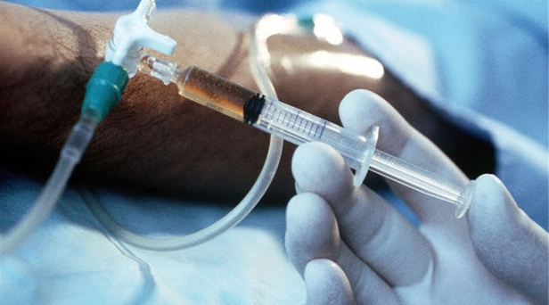
Euthanasia can also be accomplished by providing a lethal injection of a drug that will cause a painless death.
This image is courtesy of crisismagazine.com.

Slide 5
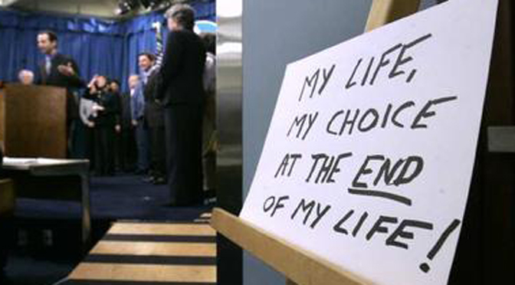
Those who are for Euthanasia state that a person has a “right to die with dignity.”
This image is courtesy of liveactionnews.org.

Slide 6
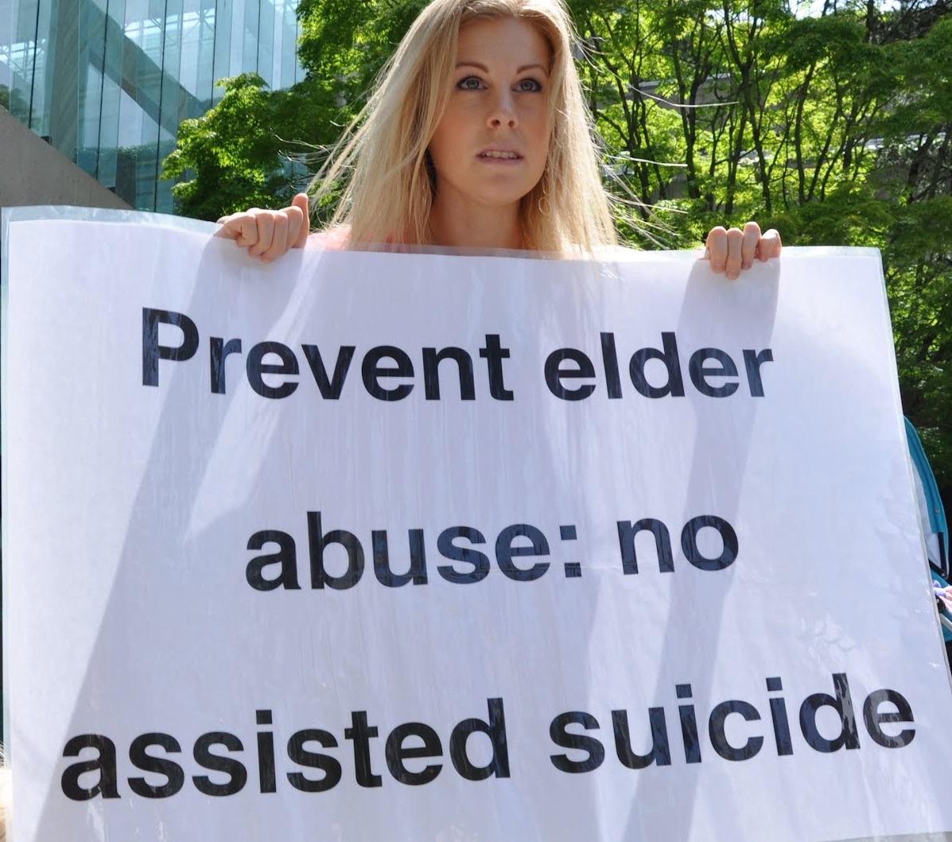
Those who are against doctor-assisted suicide (euthanasia) state that it is simply murder.
This image is courtesy of onmounthoreb.com.

Slide 7
Euthanasia (physician-assisted suicide) should be legal in the United States.
This image is courtesy of dailymaverick.co.za

Slide 8
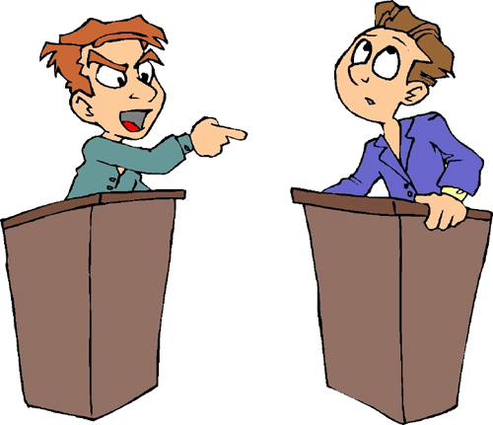
Good debaters use stories and anecdotes to support their argument.
These stories are in a lot of newspaper and magazine articles that you will read online. This image is courtesy of gova-lhs.wikispaces.com

Slide 9
Additionally, you will use Facts not Bias to support your arguments.
This image is courtesy of gova-lhs.wikispaces.com

Slide 10
Bias: Most Americans are against Euthanasia because we highly value life.
This image is courtesy of alexschadenberg.blogspot.com

Slide 11
Fact: According to the latest Gallup poll, 7 out of 10 Americans support Euthanasia. http://www.gallup.com/poll/171704/seven-americans-back-euthanasia.aspx
This image is courtesy of youtube.com

Slide 12
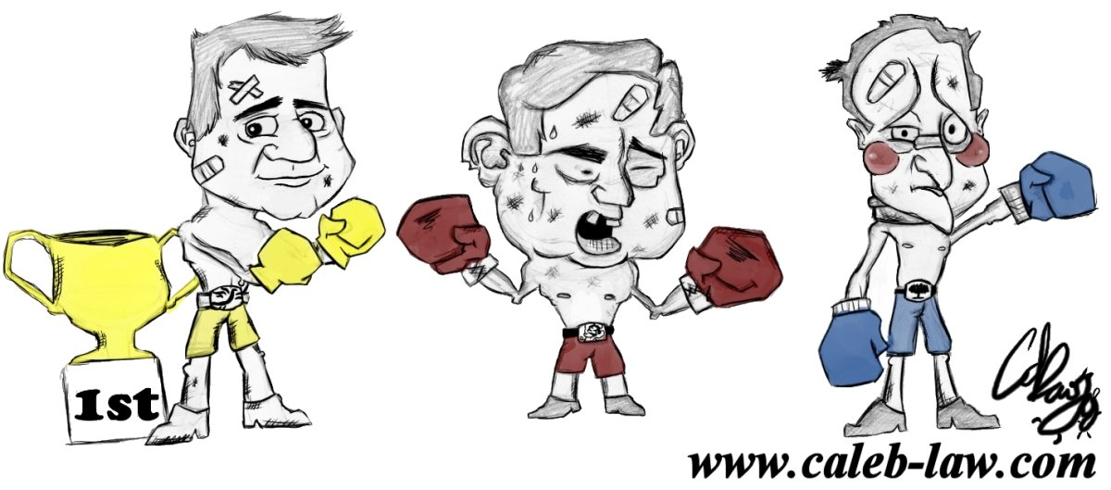
The teacher will be the moderator.
The job of the moderator is to speak clearly and to keep everyone on task in a respectful manner. The moderator introduces the debate topic and recognizes students to speak by alternating between “pro” and “con” students. This image is courtesy of generalelection2010.com

Slide 13
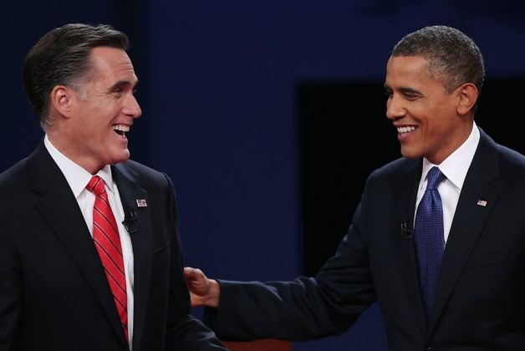
Debate Rules:
Be polite, courteous, and respectful, and listen carefully to both sides.
This image shows President Barack Obama and challenger Mitt Romney during a debate during the 2012 Presidential Campaign. This image is courtesy of www.sfgate.com

Slide 14
Each side will make two opening statements. They will include both side’s opinion, and a brief overview of the supporting evidence for those opinions.
To understand an opponent’s weaknesses, one must understand their opinions and the source of their opinions. This image is courtesy of savingmemoir.wordpress

Slide 15
The moderator will allow the students from both sides to “huddle” for 45 seconds before they respond to the statement.
During the “huddle,” they will explain to each other the weaknesses of the other side, and what information that they must find to refute their opponent’s attack. They should pick someone to make a rebuttal to the other side’s opening statements. This image is courtesy of vistahumanities19.wikispaces.com

Slide 16
Both sides will make Rebuttals to the Opening Statements. Approximately 1 Minute
During Rebuttal, a student should: A. Rebut a previous statement by an opponent OR
B. Ask a specific opponent a question about the opponent’s previous statement.
This image is courtesy of inanage.com.

Slide 17
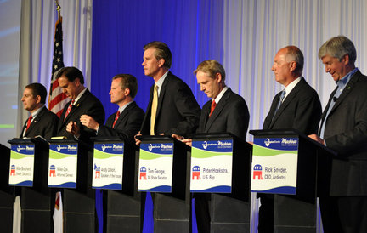
After a student speaks 2 times, they will not be allowed to speak again until everyone else on their team has had a chance to speak at least 1 time.
This image is courtesy of www.quazoo.com

Slide 18
The Proposition side will make a Statement. Approximately 1 Minute
These statements can: A. Rebut a previous statement,
B. Make a fact based statement that you have already prepared.
C. Tell a story/anecdote that you have already prepared.
This image is courtesy of abcgreatpix.com.

Slide 19
The Opposition side will make Statement. Approximately 1 Minute
These statements can: A. Rebut a previous statement,
B. Make a fact based statement that you have already prepared.
C. Tell a story/anecdote that you have already prepared.
This image is courtesy of keepcalm0matic.co.uk.

Slide 20
The Proposition side will make a Statement. Approximately 1 Minute
These statements can: A. Rebut a previous statement,
B. Make a fact based statement that you have already prepared.
C. Tell a story/anecdote that you have already prepared.
This image is courtesy of abcgreatpix.com.

Slide 21
The Opposition side will make Statement. Approximately 1 Minute
These statements can: A. Rebut a previous statement,
B. Make a fact based statement that you have already prepared.
C. Tell a story/anecdote that you have already prepared.
This image is courtesy of keepcalm0matic.co.uk.

Slide 22
The moderator will allow the students from both sides to “huddle” for 45 seconds before they respond to the statement.
During the “huddle,” they will explain to each other the weaknesses of the other side, and what information that they must find to refute their opponent’s attack. They should choose who is going to make their rebuttal. This image is courtesy of vistahumanities19.wikispaces.com

Slide 23
Both sides will make rebuttals to the one minute statements. The rebuttals will be for approximately 1 Minute.
During Rebuttal, a student should: A. Rebut a previous statement by an opponent OR
B. Ask a specific opponent a question about the opponent’s previous statement.
This image is courtesy of keepcalm0matic.co.uk.

Slide 24
While both side speak, students should be taking notes on the debate script to help them during the time when it is their turn to speak.
At this point, one should be taking notes to help you in your rebuttal, and to respond to the other side’s rebuttal. Keep your head down, do not show much emotion. Do not show your opponent how effective or laughable their arguments are. This image is courtesy of hercampus.com.

Slide 25
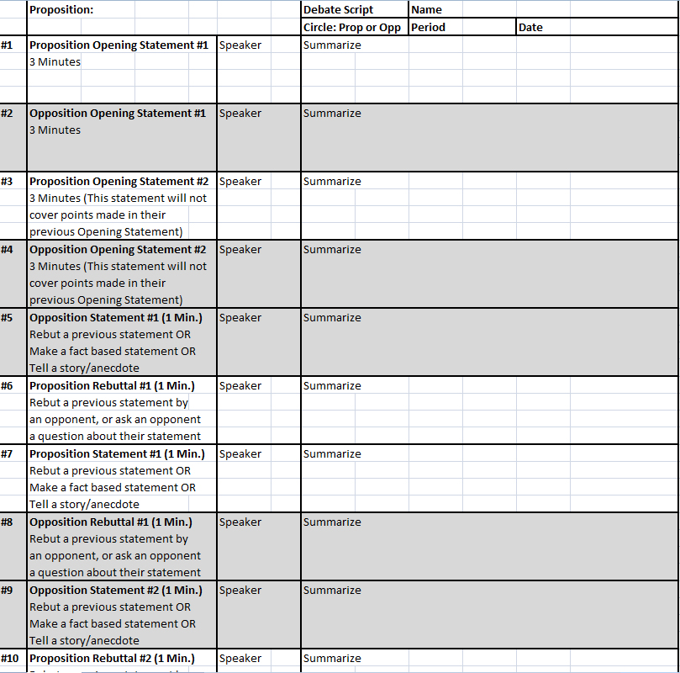
Use your Debate Scripts to understand exactly where we are in the debate, and what is being said in the debate.
The debate script shows step by step who is supposed to speak and when. First put your Name, Period, and Date on the script. This image was created by Mr. Robert Housch.

Slide 26
Write in the Proposition on your Debate Script: Euthanasia (physician-assisted suicide) should be legal in the United States.
Then circle if you are on the Proposition side, or on the Opposition side. This image was created by Mr. Robert Housch.

Slide 27
When you are instructed, you will meet with your group and discuss who is doing what task, Opening Statement, Closing Statement, etc… and what you will cover.
Write a summary of your statements in the box which is labeled “summarize.” This image was created by Mr. Robert Housch.

Slide 28
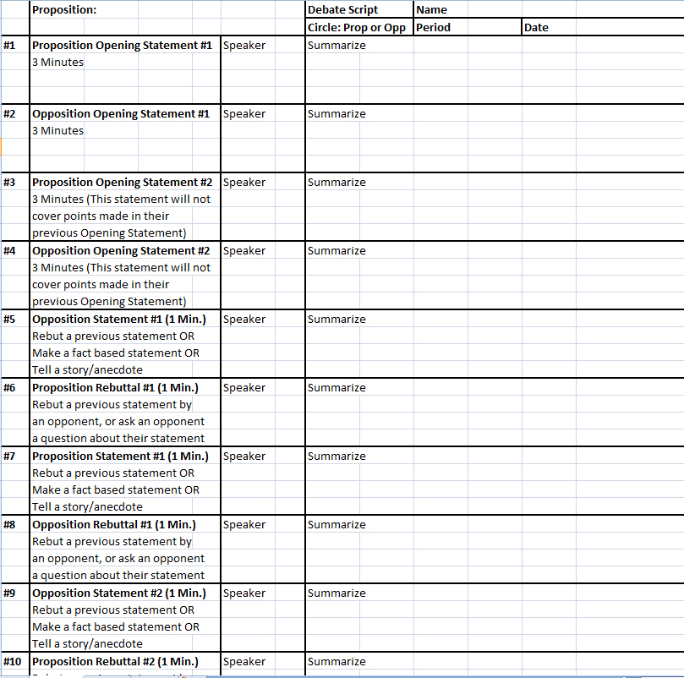
While someone is speaking, write on your debate script in the box labeled “Speaker” who is speaking, and in the box labeled “Summarize” a brief description of what they said.
When someone is speaking, you should be constantly writing on the script. This image was created by Mr. Robert Housch.

Slide 29
The debate ends with closing statements from both sides.
The “Proposition” side speaks first, followed by the “Opposition” side. In the final huddle, the students will decide which student will represent them by giving the closing statement for their side. This image is courtesy of www2.humboldteducation.com

Slide 30
The closing statement (approximately 3 minutes) should restate the opinions with strong supporting evidence.
You will restate your side’s opinion, not the opposition’s opinion. Each student should have a statement ready in case they are called upon to make either an opening statement or a closing statement if those people previously assigned those positions are not present during the debate.. This image is courtesy of enfe2012bioteca.wikispaces.com

Slide 31
The students will objectively vote on who they believe won the debate.
Notice we are not saying who is right or wrong, but who we believe won the debate. This image is courtesy of www.satirecartoonists.com

Slide 32
The judges/moderators will objectively vote on who they believe won the debate.
Notice we are not saying who is right or wrong, but who we believe won the debate. This image is courtesy of mannuhn.deviantart.com.

Slide 33
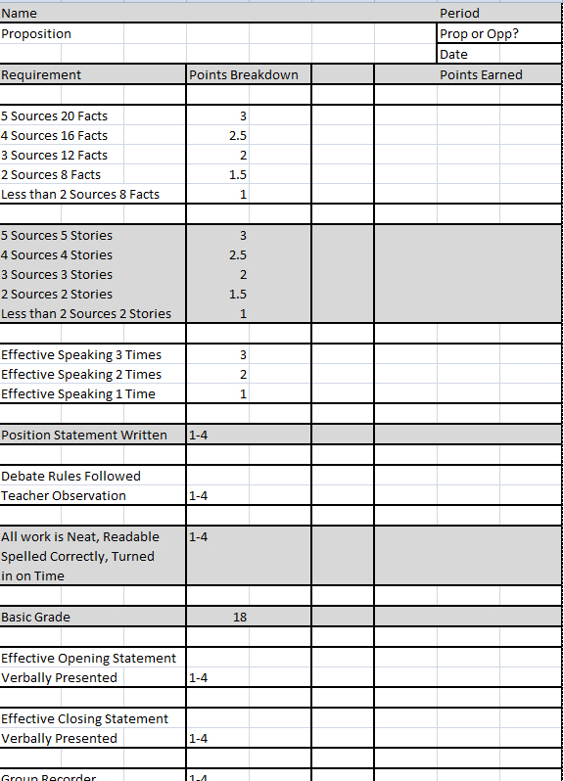
Your final grade for the debate will be placed on the Debate Rubric.
One may earn extra points by either giving the opening argument or the closing argument to their side of the debate. This image was created by Robert Housch.

Slide 34
Possible Way for your group to divide up this topic:
A. How many incidents of Physician-Assisted Suicide (or euthanasia) in the United States? How many in the world? What are the laws in other countries regarding Physician-Assisted Suicide or euthanasia? B. Should there be an age limit to Physician-Assisted Suicide? Does someone have to be mentally competent to request euthanasia? Who should make decisions for incapacitated individuals (such as someone in a persistent vegetative state)? C. What is a living will? Are living wills a good idea? D. What is quality of life, and how does it relate to euthanasia? E. Is euthanasia a good solution to terminal illnesses? F. How do churches feel about euthanasia? Do churches differ in their opinion on euthanasia? How do different religions differ on their opinion towards euthanasia? G. Have any states legalized euthanasia? Is euthanasia necessary if advances in medical science will soon cure the disease someone is suffering from? H. Should there be a punishment for those who assist someone with euthanasia in states where it is illegal? What should the punishment be? What is currently the punishment for euthanasia in different states or countries? I. Why do patients request Physician-Assisted death? (for our purposes, euthanasia) J. Should euthanasia and physician-assisted suicide only be allowed for the terminally ill? Are there cases where it should be allowed for someone not terminally ill? K. Would legalizing euthanasia and physician-assisted suicide save money for the American health care system? Would it save money for insurance companies? Would it save money for families? How would it impact hospitals? L. Is a physician ever obligated to help a patient with euthanasia? Does euthanasia (physician-assisted death) violate the Hippocratic Oath?

Slide 35
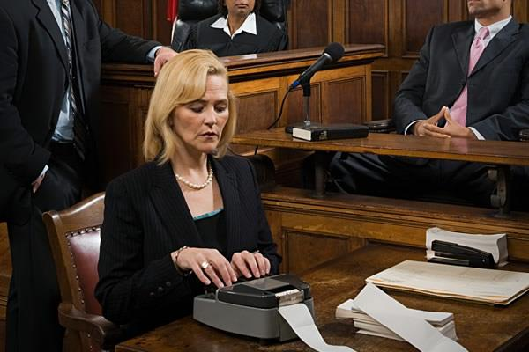
A recorder needs to be chosen for your group. The recorder will e-mail Mr. Housch a list of who is making what statement, and who is speaking on what topic.
One may earn extra points by either giving the opening statement, the closing statement, or being a recorder for their side of the debate. The recorder will also keep track of how many times the people in their group speak during the debate. This image was created by Robert Housch.

Slide 36
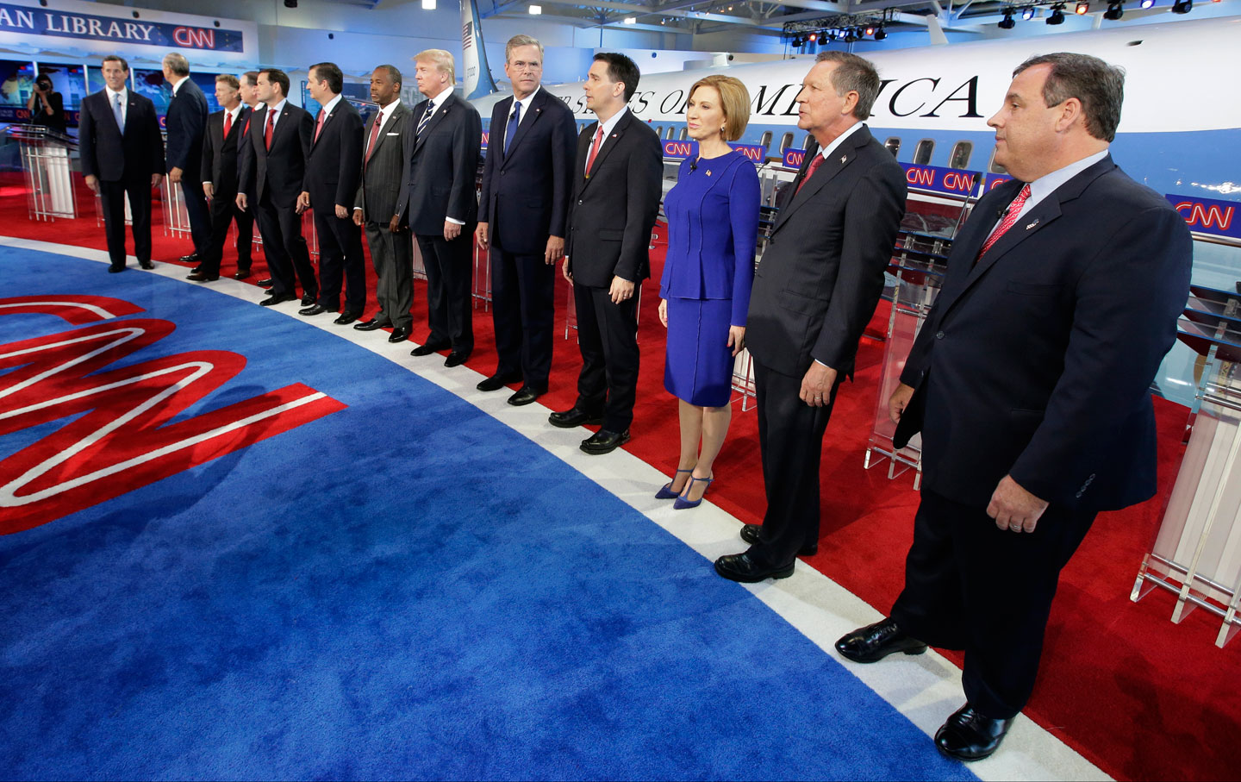
Let’s divide up your work by deciding who is doing opening statements, closing statements, who is the recorder, and the one minute statements.
We will use your debate scripts and the debate script power point. This image is courtesy of thenation.com

Slide 37
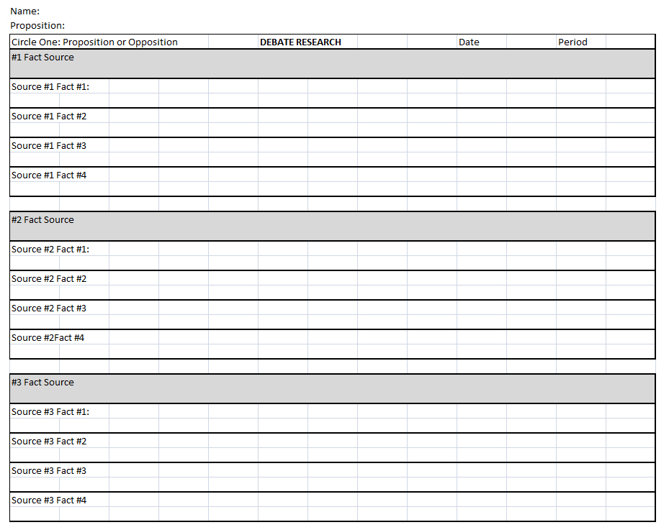
Fill out the Debate Template as you do your research.
First fill in your name, and the Proposition: “Congress should make a law that bans American civilians from owning guns.” This image is courtesy of Mr. Robert Housch.

Slide 38
You will see a line with a “Fact Source.” Below that are as many as four facts that you acquired from that source.
More than 5 Sources and 20 Facts is a “4.” 5 Sources and 20 Facts is a “3.” 4 Sources and 16 Facts is a “2.5.” 3 Sources and 12 Facts is a “2.” 2 Sources and 8 Facts is a “1.5” Below 2 Sources and 8 Facts is a “1.” This image is courtesy of Mr. Robert Housch.

Slide 39
You will also see a section on Stories/Anecdotes.
More than 5 Sources and 5 Stories is a “4.” 5 Sources and 5 Stories is a “3.” 4 Sources and 4 Stories is a “2.5.” 3 Sources and 3 Stories is a “2.” 2 Sources and 2 Stories is a “1.5” Below 2 Sources and 2 Stories is a “1.” This image is courtesy of Mr. Robert Housch.

Slide 40
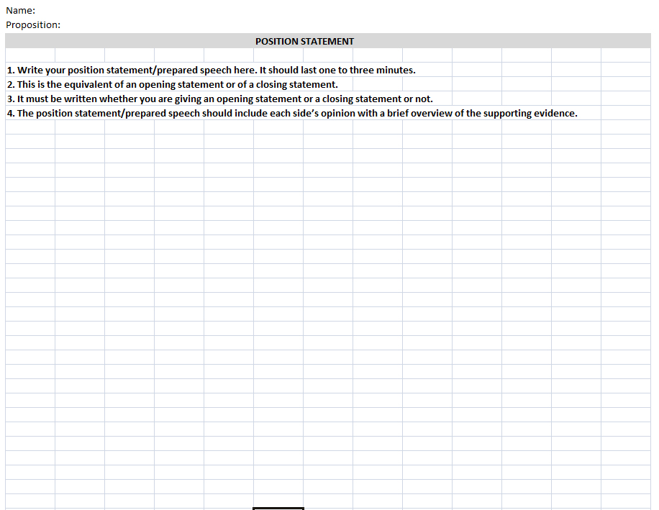
Finally, as part of your research, you need to write an approximately three minute speech to be used as a position statement when the debate begins.
You must write this statement whether or not you are giving an opening statement or a closing statement during the debate. This image is courtesy of Mr. Robert Housch.

Slide 41
Recommended Research Sites
http://euthanasia.procon.org/ http://www.bbc.co.uk/ethics/euthanasia/ http://www.pewresearch.org/topics/death-and-dying/ http://www.cnn.com/2014/11/26/us/physician-assisted-suicide-fast-facts/ http://www.thehastingscenter.org/Publications/BriefingBook/Detail.aspx?id=2202 http://www.patientsrightscouncil.org/site/holland-background/ http://www.life.org.nz/euthanasia/euthanasia3/ https://en.wikipedia.org/wiki/Terri_Schiavo_case http://abcnews.go.com/Health/terri-schiavo-10-years-death-end-life-debate/story?id=30013571 http://time.com/3678199/brittany-maynard-death-with-dignity-legislation-california/

Slide 42
Recommended Research Sites
http://time.com/3763521/terri-schiavo-right-to-die-brittany-maynard/ http://time.com/4054178/right-die-doctor-california/ http://www.deathwithdignity.org/historyfacts/questions https://en.wikipedia.org/wiki/Voluntary_euthanasia http://time.com/4054178/right-die-doctor-california/ http://www.worldrtd.net/es/euthanasia-and-world http://www.nytimes.com/2007/03/21/opinion/21iht-edsokol.4978393.html http://wrtl.org/assisted-suicide/fast-facts-assisted-suicide/ http://www.nytimes.com/roomfordebate/2014/10/06/expanding-the-right-to-die http://listverse.com/2014/11/15/10-heartbreaking-right-to-die-cases/ https://www.rnw.org/archive/nine-myths-about-euthanasia-netherlands

Slide 43
During your research, don’t automatically raise your hand to ask Mr. Mr. Housch a question about what something means.
You have a powerful took at your disposal called the internet. Look up words on websites such as dictionary.com or wikipedia.com. This image is courtesy of photomatt7.wordpress.com

Slide 44
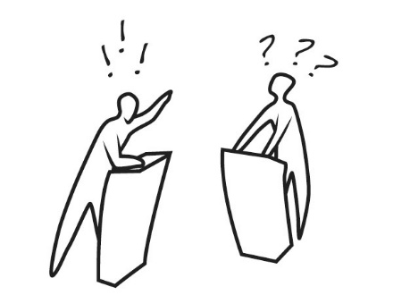
The debate will be during class on Friday.
This image is courtesy of www.lastbastile.wordpress.com

Slide 45
A recorder needs to be chosen for your group. The recorder will e-mail Mr. Housch a list of who is making what statement, and who is speaking on what topic.
One may earn extra points by either giving the opening statement, the closing statement, or being a recorder for their side of the debate. The recorder will also keep track of how many times the people in their group speak during the debate. This image was created by Robert Housch.

Slide 46
Possible Way for your group to divide up this topic:
A. How many incidents of Physician-Assisted Suicide (or euthanasia) in the United States? How many in the world? What are the laws in other countries regarding Physician-Assisted Suicide or euthanasia? B. Should there be an age limit to Physician-Assisted Suicide? Does someone have to be mentally competent to request euthanasia? Who should make decisions for incapacitated individuals (such as someone in a persistent vegetative state)? C. What is a living will? Are living wills a good idea? D. What is quality of life, and how does it relate to euthanasia? E. Is euthanasia a good solution to terminal illnesses? F. How do churches feel about euthanasia? Do churches differ in their opinion on euthanasia? How do different religions differ on their opinion towards euthanasia? G. Have any states legalized euthanasia? Is euthanasia necessary if advances in medical science will soon cure the disease someone is suffering from? H. Should there be a punishment for those who assist someone with euthanasia in states where it is illegal? What should the punishment be? What is currently the punishment for euthanasia in different states or countries? I. Why do patients request Physician-Assisted death? (for our purposes, euthanasia) J. Should euthanasia and physician-assisted suicide only be allowed for the terminally ill? Are there cases where it should be allowed for someone not terminally ill? K. Would legalizing euthanasia and physician-assisted suicide save money for the American health care system? Would it save money for insurance companies? Would it save money for families? How would it impact hospitals? L. Is a physician ever obligated to help a patient with euthanasia? Does euthanasia (physician-assisted death) violate the Hippocratic Oath?

